Slide 1
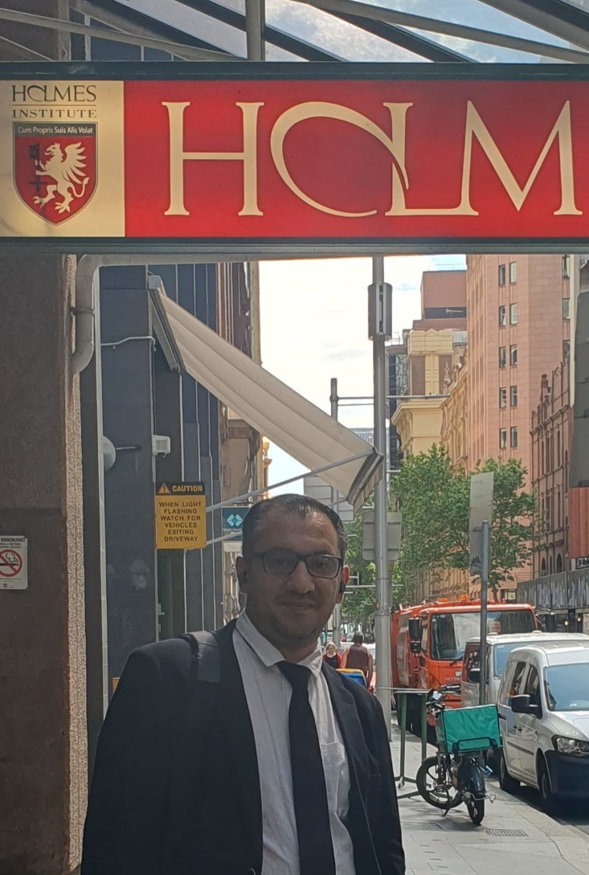

HS1021: Web Design
Weeks 6 – 7 Tutorial and Lab 3 Test Practice and Group Assignment
Dr. Farshid Keivanian

Slide 2

Preparation and Guideline for Group Assignment
Purpose of This Guide
This guide explains the group assignment in simple terms so your group understands:
What you need to do
What you need to submit
What to avoid
How to organise your work
How to prepare your website step-by-step
This is a preparation guide only. It helps you learn the process without giving complete assignment answers.

Slide 3
Preparation and Guideline for Group Assignment
1. Important Dates and Submission Rules
Due Date
19 June 2026 – 11:59 PM
Before You Start
Make sure your group:
Has officially registered on Blackboard
Has selected one business scenario
Has all member names confirmed
Understands the assignment requirements

Slide 4
Preparation and Guideline for Group Assignment
Extension Request
Holmes Institute has a process for students who miss an exam or assessment due to illness or other exceptional circumstances. I found this link for you, which may be helpful:
https://help.holmes.edu.au/what-can-i-do-if-i-missed-my-exam
Kind regards,
Dr Farshid Keivanian

Slide 5
Preparation and Guideline for Group Assignment
2. What Your Group Must Submit
Your group must submit TWO files.
File 1 – Website ZIP Folder
Submit a compressed .zip folder containing:
All HTML pages
One CSS file named styles.css
Images folder
README.txt file

Slide 6
Preparation and Guideline for Group Assignment
Example Folder Structure
sunrisecafe_HS1021_website.zip
│
├ index.html
├ menu.html
├ gallery.html
├ contact.html
├ styles.css
├ README.txt
└─ images/
├ coffee.jpg
├ cafe.jpg
└─ logo.png

Slide 7
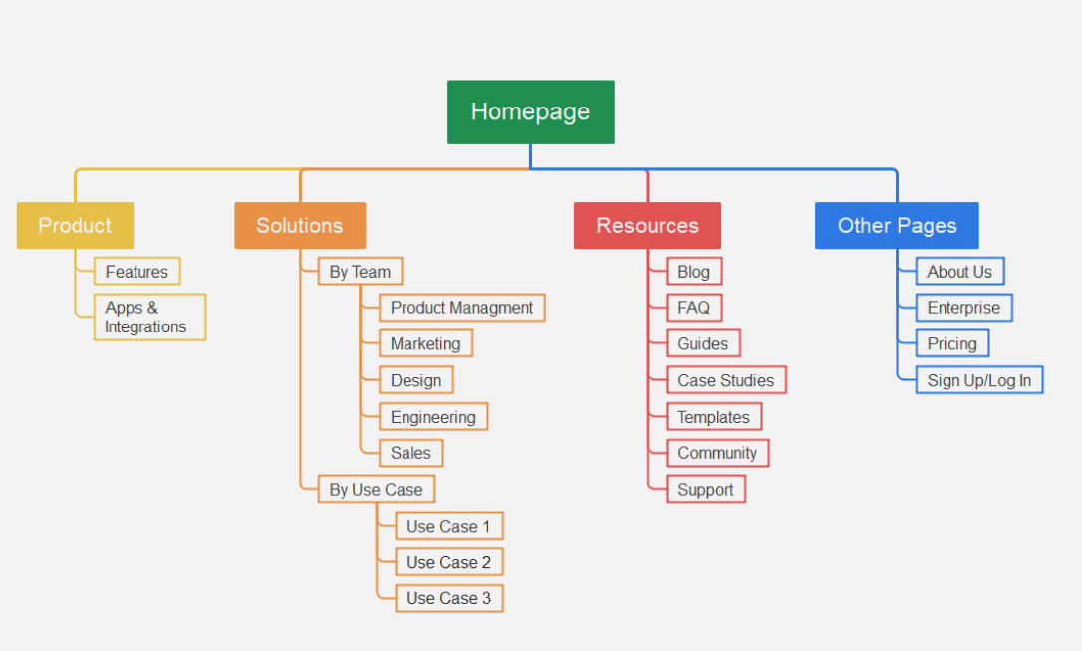
Preparation and Guideline for Group Assignment
File 2 – Design and Technical Report
Submit a Microsoft Word document (.docx) containing:
Cover sheet
Client requirements summary
Site map
Wireframes
Style guide
Technical explanation
Individual reflections
References
Example

Slide 8
Preparation and Guideline for Group Assignment
3. Group Scenario Selection
Your group must choose ONE business category.
Example Topics
Category | Example
Café or Restaurant | Sunrise Café
Fitness Studio | Ignite Fitness
Charity | Green Future Foundation
Tourism | Blue Mountain Lodge
Festival | Riverside Music Festival

Slide 9
Preparation and Guideline for Group Assignment
4. Minimum Website Requirements
Your website must:
Include at least 4 pages
Use HTML5 semantic elements
Use ONE external CSS file
Have working navigation links
Be responsive on mobile and desktop
Include a contact form
Pass W3C validation

Slide 10
Preparation and Guideline for Group Assignment
5. Understanding Semantic HTML5
Semantic elements help structure your website clearly.
Common Semantic Elements
Element | Purpose
<header> | Top section/logo
<nav> | Navigation menu
<main> | Main page content
<section> | Content section
<article> | Independent content block
<footer> | Bottom section

Slide 11
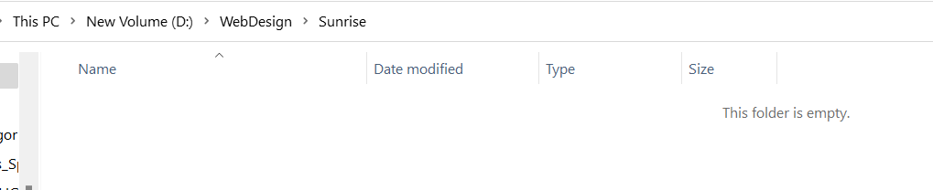
Preparation and Guideline for Group Assignment
Simple Example
Create a Folder e.g., WebDesign >> Sunrise

Slide 12
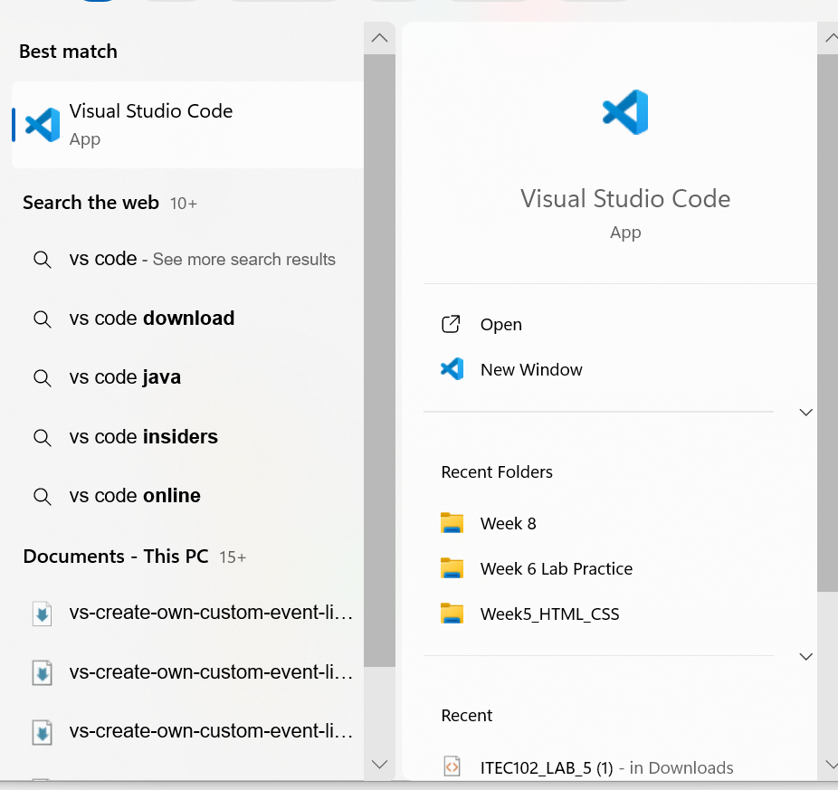
Preparation and Guideline for Group Assignment
Run VS Code

Slide 13
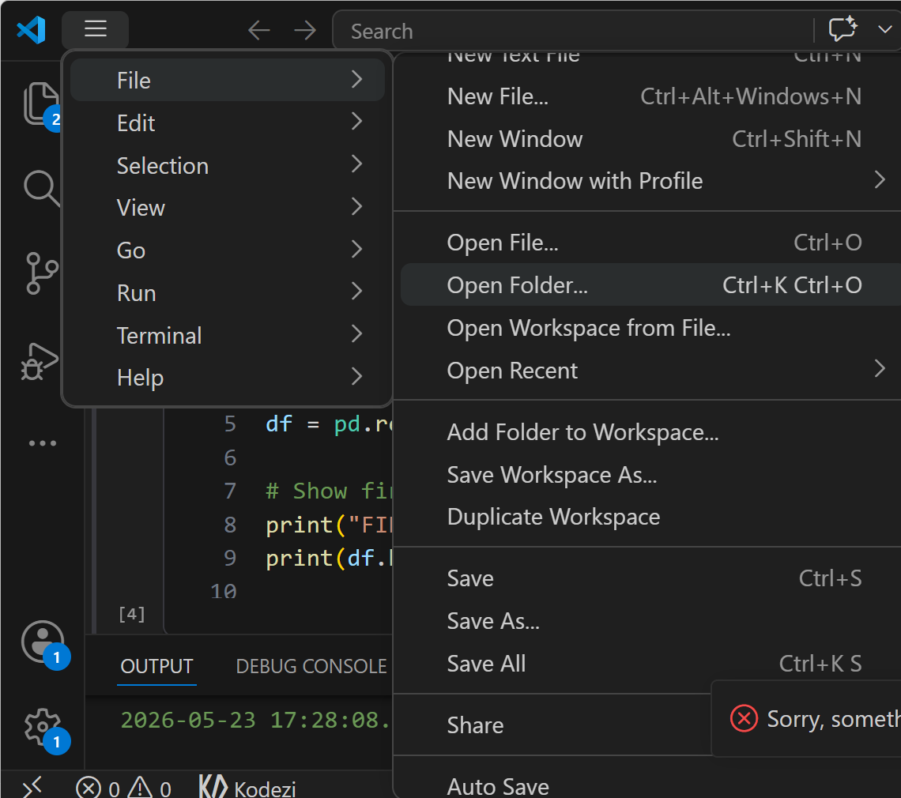
Preparation and Guideline for Group Assignment
File >> Open Folder

Slide 14
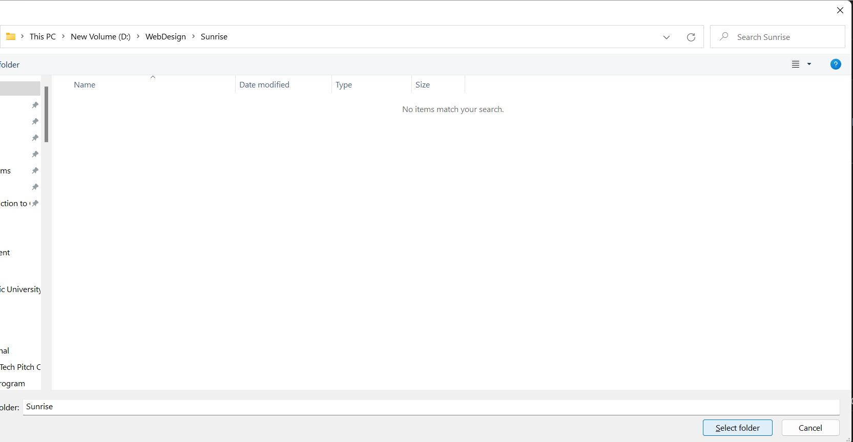
Preparation and Guideline for Group Assignment
Navigate the folder (e.g., Webdesign >> Sunrise then Select folder)

Slide 15
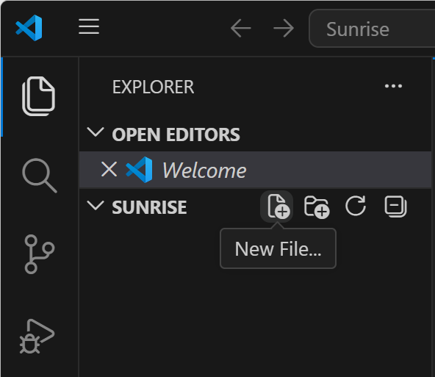
Preparation and Guideline for Group Assignment
Select New File

Slide 16
Preparation and Guideline for Group Assignment
Students first learn the basic structure before building a complete website. After teaching this part, students should continue developing the website step-by-step instead of stopping at a simple page.

Slide 17
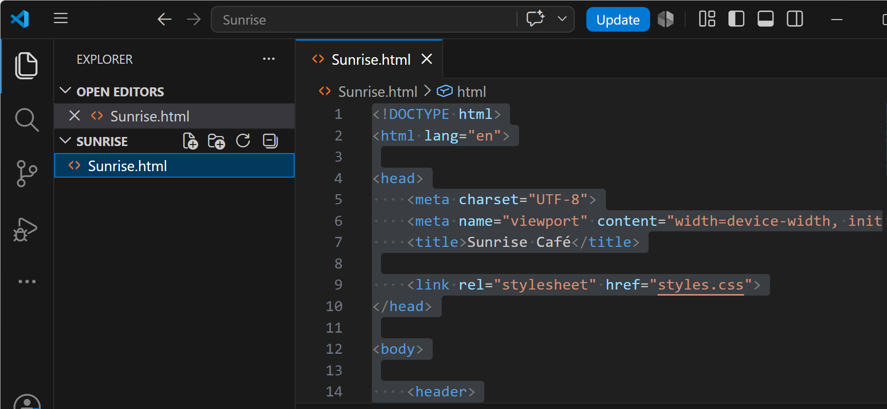
Preparation and Guideline for Group Assignment
You may select a name (e.g., Sunrise.html)

Slide 18
<!DOCTYPE html>
<html lang="en">
<head>
<meta charset="UTF-8">
<meta name="viewport" content="width=device-width, initial-scale=1.0">
<title>Sunrise Café</title>
<link rel="stylesheet" href="styles.css">
</head>
<body>
<header>
<h1>Sunrise Café</h1>
</header>
<nav>
<a href="index.html">Home</a>
<a href="menu.html">Menu</a>
<a href="contact.html">Contact</a>
</nav>
<main>
<section>
<h2>Welcome</h2>
<p>Fresh coffee every morning.</p>
</section>
</main>
<footer>
<p>© 2026 Sunrise Café</p>
</footer>
</body>
</html>

Slide 19
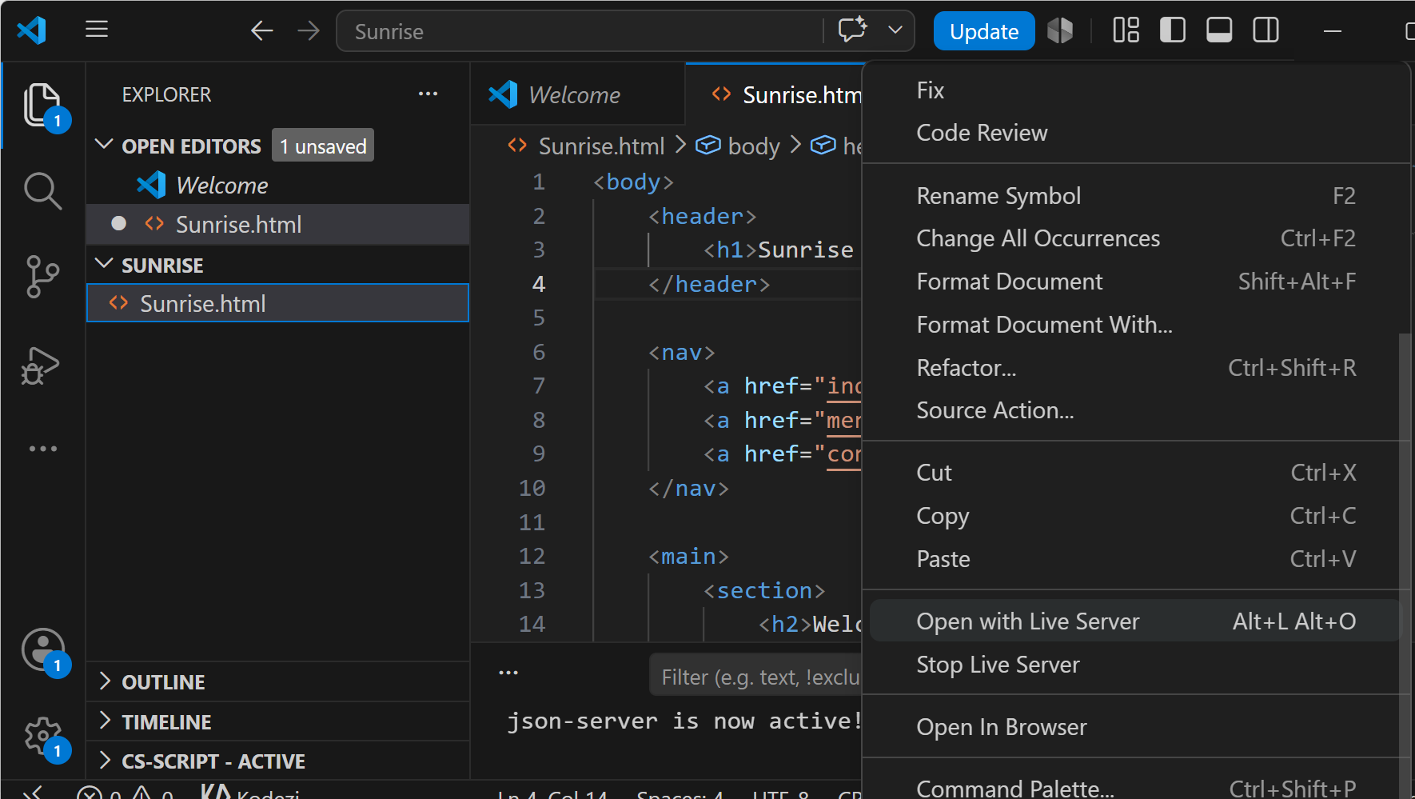
Right Click >> Open with Live Server

Slide 20
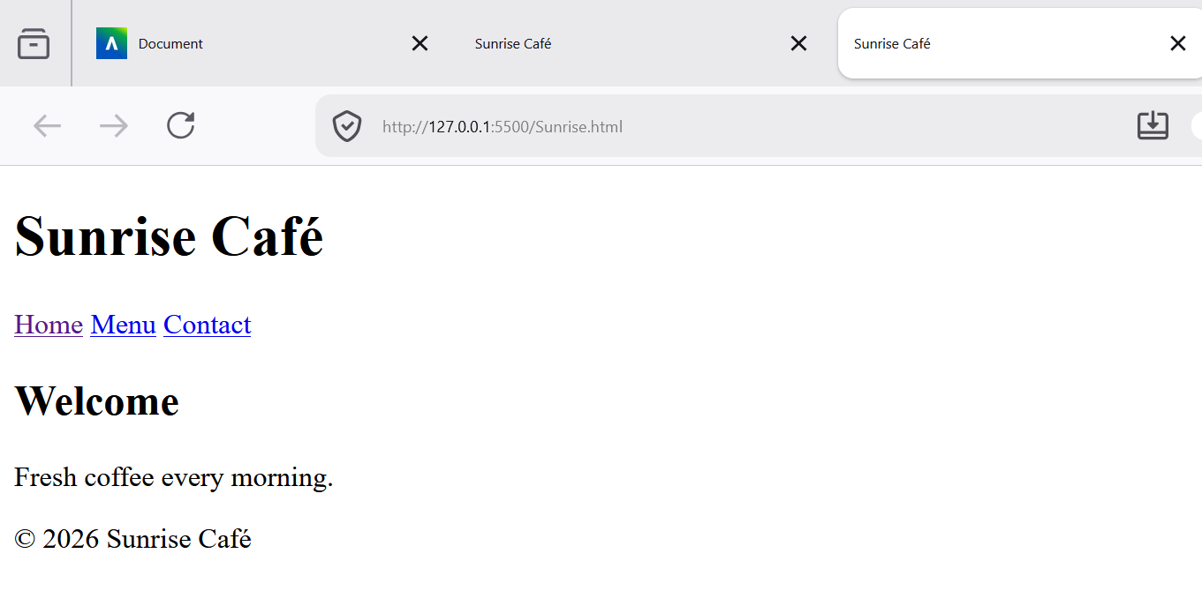
Right Click >> Open with Live Server

Slide 21
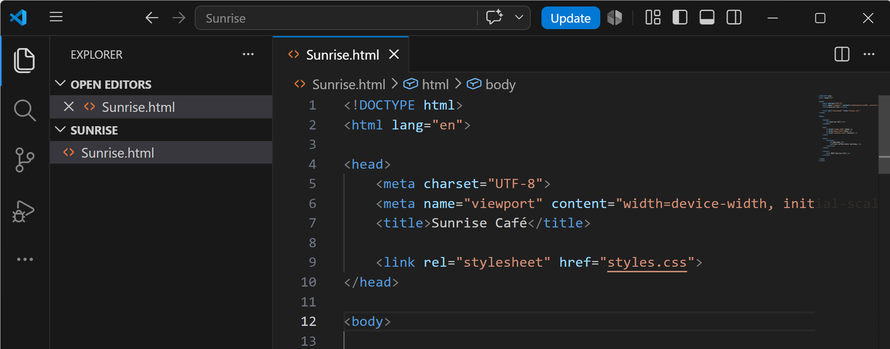
Preparation and Guideline for Group Assignment
6. Using External CSS Correctly
You must use ONE external CSS file.
Correct Method
HTML: <link rel="stylesheet" href=“styles.css">

Slide 22
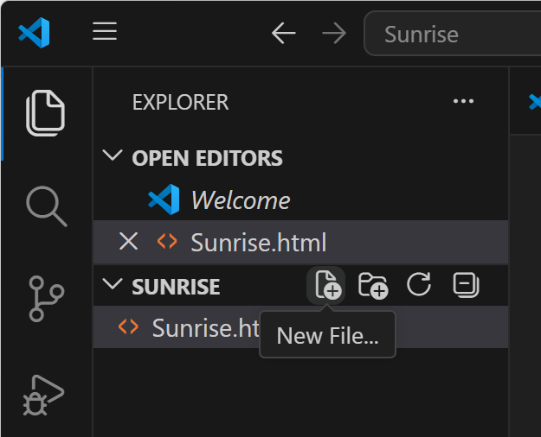
Preparation and Guideline for Group Assignment
Click New File

Slide 23
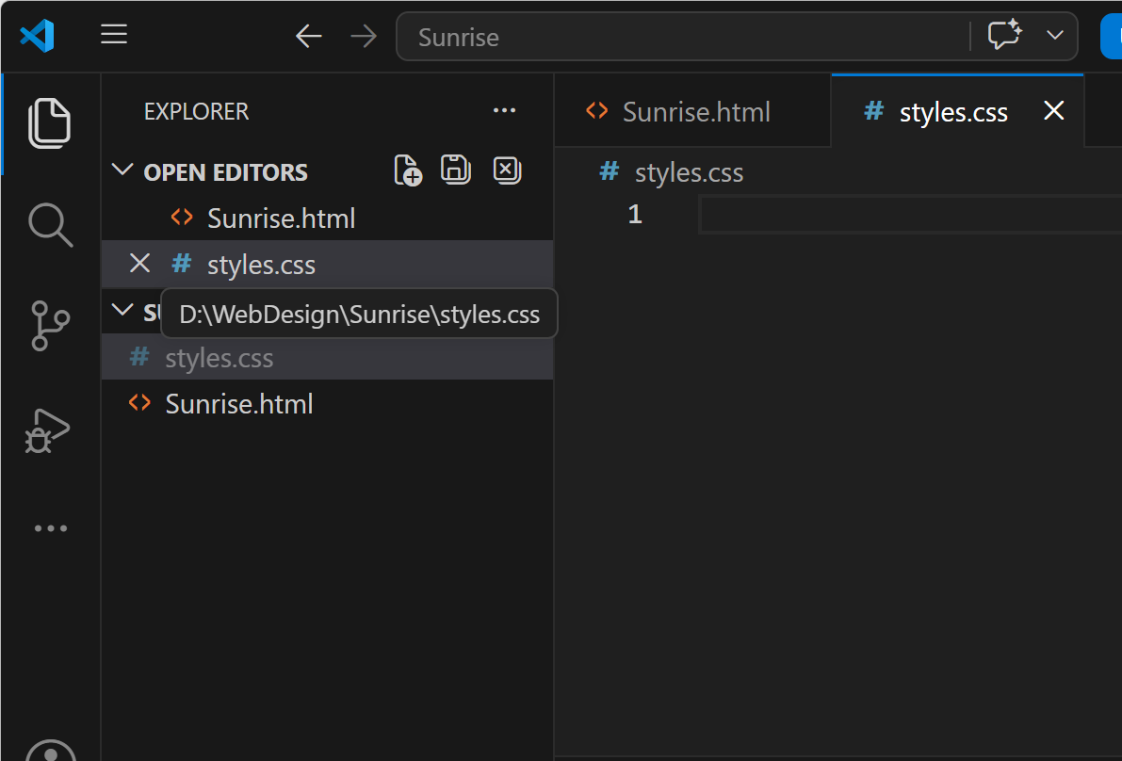
Preparation and Guideline for Group Assignment
Choose a name (e.g., styles.css)

Slide 24
Write CSS code
/* Reset some default browser spacing */
body {
font-family: Arial, sans-serif;
margin: 0;
background-color: #f5f5f5;
color: #333;
}
/* Header section */
header {
background-color: #5c4033;
color: white;
text-align: center;
padding: 20px;
}
/* Navigation bar */
nav {
background-color: #333;
text-align: center;
padding: 10px;
}
/* Navigation links */
nav a {
color: white;
text-decoration: none;
margin: 10px;
padding: 8px 12px;
display: inline-block;
}
1. margin
margin: 0;
Removes browser default spacing.
2. padding
padding: 20px;
Adds space INSIDE elements.
3. background-color
background-color: #333;
Changes background colour.

Slide 25
/* Hover effect */
nav a:hover {
background-color: #555;
border-radius: 5px;
}
/* Main content area */
main {
padding: 20px;
}
/* Section styling */
section {
background-color: white;
padding: 20px;
border-radius: 8px;
}
/* Footer styling */
footer {
background-color: #5c4033;
color: white;
text-align: center;
padding: 10px;
margin-top: 20px;
}
/* Responsive design */
@media (max-width: 768px) {
nav a {
display: block;
margin: 5px 0;
}
}
4. text-decoration
text-decoration: none;
Removes underlines from links.
5. Hover Effect
nav a:hover
Changes appearance when mouse moves over links.
Students usually enjoy learning this part.

Slide 26
/* Hover effect */
nav a:hover {
background-color: #555;
border-radius: 5px;
}
/* Main content area */
main {
padding: 20px;
}
/* Section styling */
section {
background-color: white;
padding: 20px;
border-radius: 8px;
}
/* Footer styling */
footer {
background-color: #5c4033;
color: white;
text-align: center;
padding: 10px;
margin-top: 20px;
}
/* Responsive design */
@media (max-width: 768px) {
nav a {
display: block;
margin: 5px 0;
}
}
6. Responsive Design
@media (max-width: 768px)
Explains mobile-friendly websites.
Very important for assignment rubric.

Slide 27
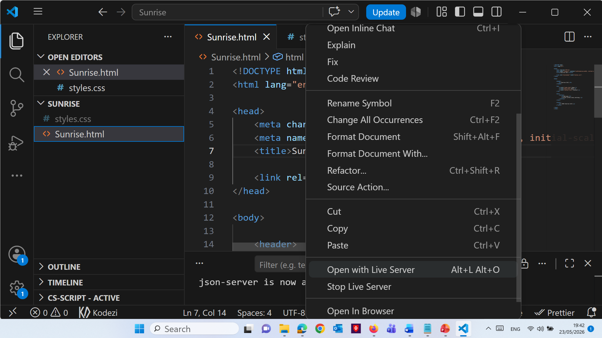
Right click >> Open with live Server

Slide 28
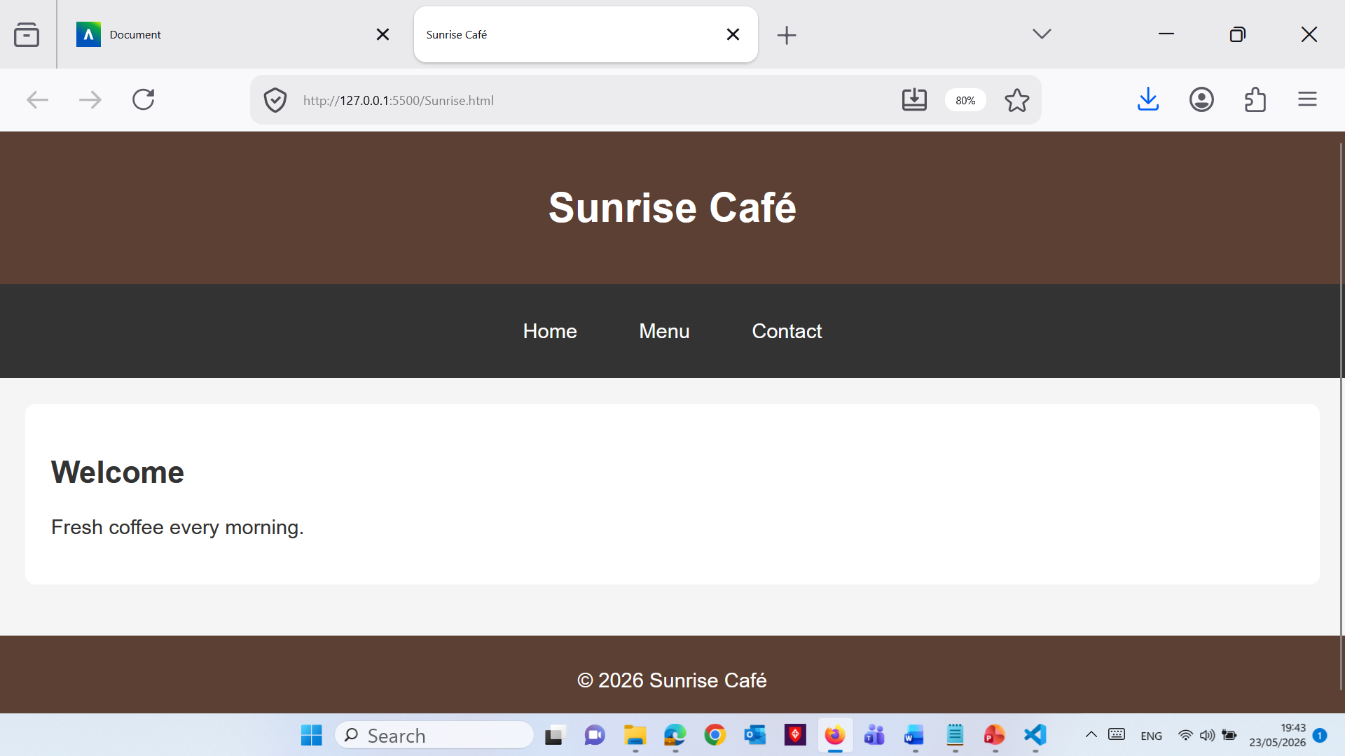
Good to Start from here

Slide 29
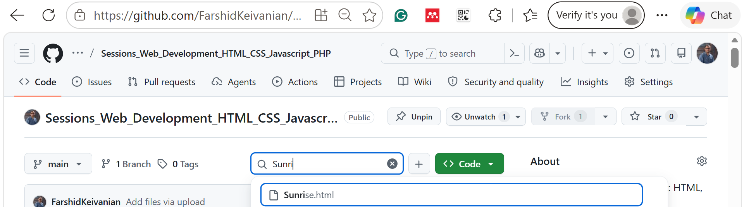
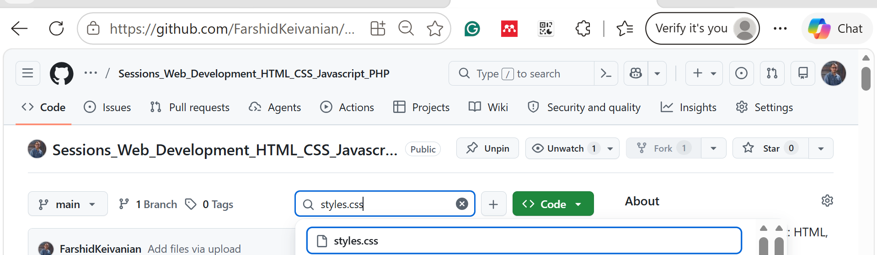
Preparation and Guideline for Group Assignment
Both html and css files are available on GitHub (good to start from here)

Slide 30
Preparation and Guideline for Group Assignment
At this stage, you already know:
basic HTML structure
linking CSS
semantic elements
simple styling
navigation
responsive basics

Slide 31
Preparation and Guideline for Group Assignment
Now the next tasks should help you gradually transform this simple page into a proper multi-page business website for the assignment.
You should now move from:
“basic page coding” towards “building a complete website project”.

Slide 32
Preparation and Guideline for Group Assignment
Task 1 — Create Additional Pages
What Students Should Do
Create the remaining website pages:
menu.html
gallery.html
contact.html

Slide 33
Preparation and Guideline for Group Assignment
Each page should:
use the same header
use the same navigation
use the same footer
connect correctly using links

Slide 34
Preparation and Guideline for Group Assignment
Hint for Students
Students can copy the existing structure and change only the <main> section.
Example:
<main> <section> <h2>Our Menu</h2> <p>Explore our breakfast and coffee options.</p> </section> </main>

Slide 35
Preparation and Guideline for Group Assignment
What to Avoid
Different navigation on each page
Missing CSS link
Broken links
Different page styles
What to Submit
Students should submit:
all HTML pages
updated CSS file

Slide 36
Preparation and Guideline for Group Assignment
Task 2 — Add Images Properly
What Students Should Do
Create an /images folder and add:
café images
menu photos
gallery images

Slide 37
Preparation and Guideline for Group Assignment
Hint for Students
Example:
<img src="images/coffee.jpg" alt="Fresh coffee served at Sunrise Café">
Students should:
always use alt
resize large images
use royalty-free images

Slide 38
Preparation and Guideline for Group Assignment
What to Avoid
huge image files
missing alt
random internet images without permission
What to Submit
images folder
updated HTML pages

Slide 39
Preparation and Guideline for Group Assignment
Task 3 — Create a Hero Section
What Students Should Do
Add a large welcome section to homepage.
Example Structure
<section class="hero">
<h2>Start Your Day With Great Coffee</h2>
<p>Freshly brewed coffee and homemade pastries.</p>
</section>

Slide 40
Preparation and Guideline for Group Assignment
CSS Hint
.hero {
background-color: #e8d8c4;
padding: 40px;
text-align: center;
}

Slide 41
Preparation and Guideline for Group Assignment
What to Avoid
too much text
oversized headings
bright unreadable colours

Slide 42
Preparation and Guideline for Group Assignment
Task 4 — Improve Navigation Styling
What Students Should Do
Improve menu appearance:
spacing
hover effect
alignment

Slide 43
Preparation and Guideline for Group Assignment
Example Hint
nav a:hover { background-color: #777; }
What to Avoid
links too close together
inconsistent colours
unreadable text

Slide 44
Preparation and Guideline for Group Assignment
Task 5 — Build a Menu Layout
What Students Should Do
Create a simple café menu using:
headings
paragraphs
prices

Slide 45
Preparation and Guideline for Group Assignment
Example Hint
<section>
<h3>Cappuccino</h3>
<p>$5.50</p>
</section>

Slide 46
Preparation and Guideline for Group Assignment
Task 6 — Create a Contact Form
What Students Should Do
Add:
name field
email field
message box
submit button

Slide 47
Preparation and Guideline for Group Assignment
Example Hint
<form>
<label>Name</label>
<input type="text">
<label>Email</label>
<input type="email">
<button type="submit">Send</button>
</form>

Slide 48
Preparation and Guideline for Group Assignment
What to Avoid
missing labels
messy spacing
giant form widths
Task 7 — Make Layout More Professional
What Students Should Do
Improve:
spacing
alignment
colours
typography

Slide 49
Preparation and Guideline for Group Assignment
Hint
Teach students simple improvements:
section { max-width: 900px; margin: auto; }
This introduces layout control.

Slide 50
Preparation and Guideline for Group Assignment
Task 8 — Mobile Testing
What Students Should Do
Resize browser window and test:
navigation
images
text size
spacing

Slide 51
Preparation and Guideline for Group Assignment
Ask Students Questions
Does navigation stack properly?
Are images too large?
Is text readable on mobile?
Task 9 — Organise Project Files
Recommended Structure
project-folder/
├ index.html
├ menu.html
├ gallery.html
├ contact.html
├ styles.css
─ images/

Slide 52
Preparation and Guideline for Group Assignment
What to Avoid
random filenames
spaces in file names
images outside folder
duplicate CSS files
Task 10 — Prepare for Documentation
Now students should begin collecting material for the report.

Slide 53
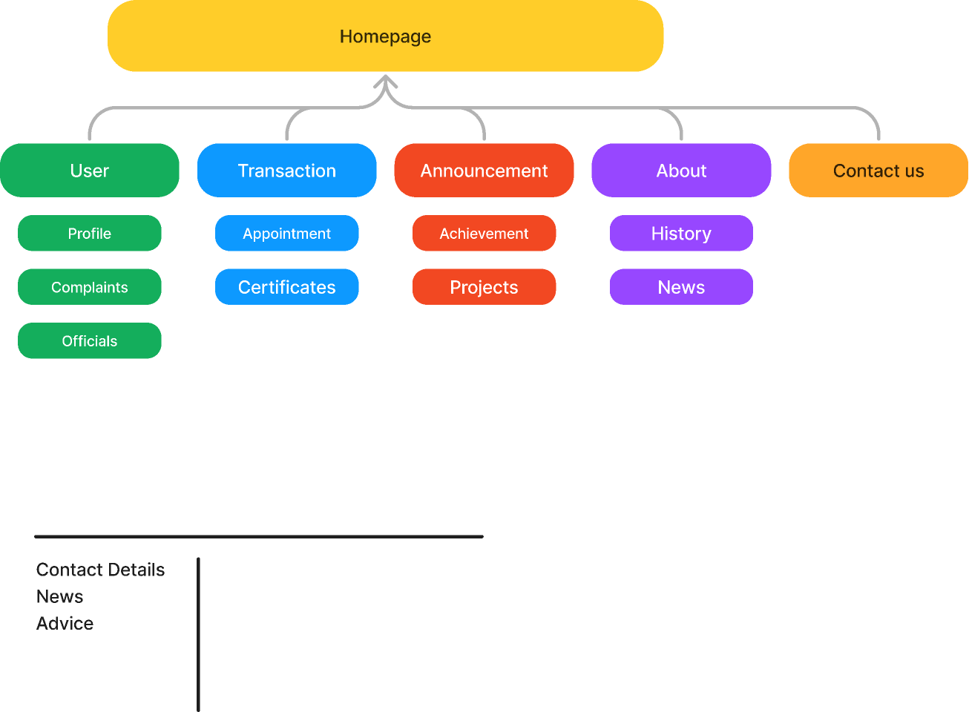
Preparation and Guideline for Group Assignment
Ask Students to Prepare
1. Site Map
Simple example:
Home ├ Menu ├ Gallery └─ Contact
Example

Slide 54
Preparation and Guideline for Group Assignment
2. Wireframes
Students can:
sketch on paper
use PowerPoint
use draw.io
3. Style Guide
Students should record:
colours
fonts
layout ideas

Slide 55
Preparation and Guideline for Group Assignment
Good Practical Weekly Goal
“By next classes your group should:
create all four pages
connect navigation links
add at least two images
build one hero section
create one contact form
improve visual styling
organise files correctly”
This gives clear achievable progress without giving full solutions.

Slide 56
Preparation and Guideline for Group Assignment
Very Important Advice
Good websites are:
clean
organised
readable
consistent

Slide 57
Preparation and Guideline for Group Assignment
Not:
overloaded with effects
copied from templates
filled with random colours
unfinished
A simple professional website is usually stronger than a complicated broken website.

Slide 58
Preparation and Guideline for Group Assignment
What Students Should Submit for the Group Assignment
Students must submit TWO main files through Blackboard.
1. Website ZIP Folder
File Name Format
Example:
groupname_HS1021_website.zip
Example:
sunrisecafe_HS1021_website.zip

Slide 59
Preparation and Guideline for Group Assignment
What Must Be Inside the ZIP Folder
HTML Pages
Minimum four pages depending on the chosen scenario.
Example:
index.html menu.html gallery.html contact.html

Slide 60
Preparation and Guideline for Group Assignment
CSS File
Students must use ONE external CSS file.
Example:
styles.css

Slide 61
Preparation and Guideline for Group Assignment
Images Folder
All images should be organised properly.
Example:
/images
Inside:
coffee.jpg
cafe.jpg
team.jpg

Slide 62
Preparation and Guideline for Group Assignment
README.txt File
This file explains:
group member names
contribution of each member
Example README.txt
Group Members: John Smith – Home page and navigation Sarah Lee – Gallery page and images Ali Khan – Contact form and CSS styling

Slide 63
Preparation and Guideline for Group Assignment
2. Design and Technical Report (.docx)
File Type Required
Microsoft Word ONLY (.docx)
NOT PDF.

Slide 64
Preparation and Guideline for Group Assignment
What the Report Must Include
1. Cover Sheet
Must include:
unit code
assignment title
all contributing members

Slide 65
Preparation and Guideline for Group Assignment
2. Client Requirements Summary
Students explain:
fictional client needs
business goals
website requirements
Example:
responsive design
easy navigation
modern café appearance

Slide 66
Preparation and Guideline for Group Assignment
3. Site Map
Example:
Home ├ Menu ├ Gallery └─ Contact

Slide 67
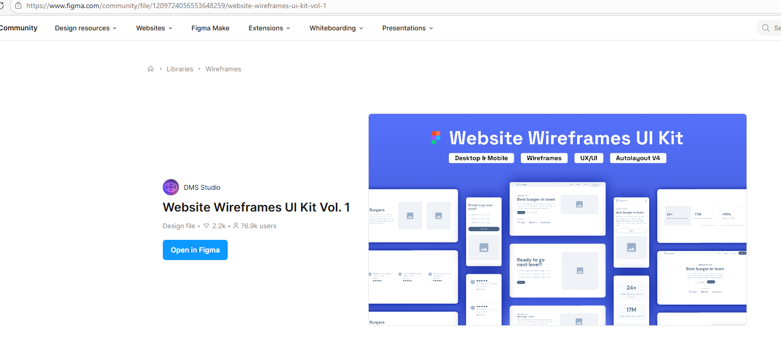
Preparation and Guideline for Group Assignment
4. Wireframes
At least TWO wireframes.
Can be:
hand drawn
PowerPoint
Figma
draw.io

Slide 68
Preparation and Guideline for Group Assignment
Must show:
layout structure
navigation
placeholders
content zones

Slide 69
Preparation and Guideline for Group Assignment
5. Style Guide
Should include:
colour palette
hex codes
fonts
spacing rules
image style

Slide 70
Preparation and Guideline for Group Assignment
6. Technical Implementation
Students explain:
semantic HTML5 used
CSS techniques
responsiveness
challenges faced
solutions used

Slide 71
Preparation and Guideline for Group Assignment
7. W3C Validation Screenshots
Students must include screenshots showing:
HTML validation
CSS validation

Slide 72
Preparation and Guideline for Group Assignment
8. Individual Reflections
Each student writes about:
contribution
learning experience
improvements for future
Approximately 100 words each.

Slide 73
Preparation and Guideline for Group Assignment
9. References
Use Adapted Harvard Referencing.
Include:
image sources
website references
tutorials if used

Slide 74
Preparation and Guideline for Group Assignment
Example Final Folder Structure
sunrisecafe_HS1021_website.zip │ ├ index.html ├ menu.html ├ gallery.html ├ contact.html ├ styles.css ├ README.txt │ └── images/ ├ coffee.jpg ├ bakery.jpg └─ cafe.jpg

Slide 75
Preparation and Guideline for Group Assignment
What Students Should Avoid
Do NOT Submit
screenshots instead of HTML files
handwritten work
PDF report
missing CSS file
broken links
empty pages
copied templates

Slide 76
Preparation and Guideline for Group Assignment
Do NOT Use
Bootstrap
Tailwind
Wix
WordPress
AI-generated full code
website builders

Slide 77
Preparation and Guideline for Group Assignment
Before Submission Checklist
Website Checklist
All pages open correctly
Navigation links work
Images display correctly
Mobile layout works
CSS linked properly
Contact form included
HTML validated
CSS validated \

Slide 78
Preparation and Guideline for Group Assignment
Report Checklist
Cover sheet included
All members listed
Site map included
Wireframes included
Style guide completed
Validation screenshots added
References included
Word count correct \

Slide 79
Preparation and Guideline for Group Assignment
Frequently Asked Questions (FAQ)
Q1. Can we use Bootstrap or Tailwind?
No.
The assignment specifically says:
no CSS frameworks
no Bootstrap
no Tailwind
Students must write their own CSS.

Slide 80
Preparation and Guideline for Group Assignment
Q2. Can we use JavaScript?
Basic JavaScript is acceptable if approved by the lecturer, but the main focus is HTML5 and CSS.
Do not rely heavily on JavaScript.

Slide 81
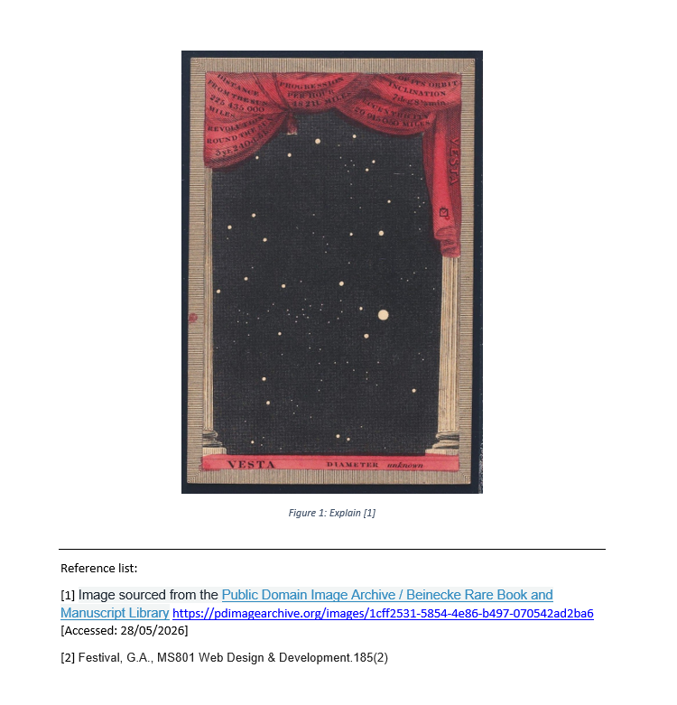
Preparation and Guideline for Group Assignment
Q3. Can we use images from Google?
Only if they are royalty-free or properly licensed.
Recommended websites:
Unsplash
Pexels
Pixabay
Public Domain Image Archive
Always reference image sources.

Slide 82
Preparation and Guideline for Group Assignment
Q4. Can one student submit for the whole group?
Yes.
But:
all contributing members must be listed
only officially registered members should be included

Slide 83
Preparation and Guideline for Group Assignment
Q5. Can we submit PDF instead of Word?
No.
The report must be:
.docx
Microsoft Word format

Slide 84
Preparation and Guideline for Group Assignment
Q6. What happens if links do not work?
Broken links may lose marks under:
navigation
usability
structure
Always test every page before submission.

Slide 85
Preparation and Guideline for Group Assignment
Q7. Do we need responsive design?
Yes.
The website must display properly on:
desktop
mobile devices

Slide 86
Preparation and Guideline for Group Assignment
Q8. Can we use inline CSS?
No.
Use:
one external CSS file only
Example:
<link rel="stylesheet" href="styles.css">

Slide 87
Preparation and Guideline for Group Assignment
Q9. What is semantic HTML?
Semantic HTML uses meaningful tags such as:
<header> <nav> <main> <section> <footer>
instead of using many generic <div> elements.

Slide 88
Preparation and Guideline for Group Assignment
Q10. How many pages are required?
Minimum:
four interlinked pages
depending on your business scenario.
Q11. What should be inside the README.txt file?
Include:
all member names
contribution of each member

Slide 89
Preparation and Guideline for Group Assignment
Q12. Do we need to validate HTML and CSS?
Yes.
Students should:
validate HTML
validate CSS
include screenshots in the report

Slide 90
Preparation and Guideline for Group Assignment
Q13. What if our website looks simple?
Simple is acceptable if:
clean
responsive
organised
functional
professionally designed
A simple working website is usually better than a complicated broken website.

Slide 91
Preparation and Guideline for Group Assignment
Q14. Can we use AI tools to generate code?
The assignment instructions say:
do not use AI code-generation tools
Students should write and understand their own code.

Slide 92
Preparation and Guideline for Group Assignment
Q15. What is the best way to divide work?
Example:
Member | Task
Student 1 | Home page
Student 2 | Menu and gallery
Student 3 | Contact form
Student 4 | CSS styling and testing
All members should still understand the full project.

Slide 93
Final Advice for Students
Start early.
Do not wait until the last week.
Good projects usually:
plan first
test regularly
keep files organised
use consistent design
focus on readability and usability
A clean and professional website with good teamwork often performs much better than an unfinished complex design.

Slide 94
Weeks 6 - 7 Tutorial
Based on the lecture 5, the topics covered include various aspects of HTML and web design, specifically focusing on hyperlinks, image management, and webpage structuring using div elements. The lecture detailed how to create different types of links such as relative, absolute, email, and telephone links. It also explained the usage of image file formats like GIF, PNG, JPG, and SVG, highlighting their unique attributes such as transparency, animation support, and compression methods. Additionally, the importance of div elements and class attributes in organizing and styling web content was discussed, alongside the use of HTML heading tags and different types of lists (unordered, ordered, and description) to structure content effectively.

Slide 95
Weeks 6 - 7 Tutorial
To prepare for the practical tasks in "Weeks 6-7 Lab.pdf" using concepts from Lecture 5, we could assign a project that consolidates our understanding of HTML and CSS with a focus on web design practices, particularly around hyperlinks, image management, and structuring web content using div elements.
Suggested Project Overview:
Objective: We will build a mini-website for a fictional local business (e.g., "Sydney Bike Tours") that incorporates various web design elements discussed in both the lectures and the lab tasks.

Slide 96
Weeks 6 - 7 Tutorial
Project Tasks:
1. Website Setup:
Create an HTML document named index.html.
Link a CSS file styles.css for styling.
2. Content Structuring:
Use div elements to structure the page into logical sections such as Header, Main Content, and Footer.
Within the Main Content, use further div elements to separate different tour packages.
3. Hyperlinks:
Implement relative links to navigate between pages like Home, About Us, and Contact.
Add absolute links to external resources such as bike safety tips or local traffic laws.
Create email links for contacting the tour manager and telephone links for immediate bookings.

Slide 97
Weeks 6 - 7 Tutorial
4. Image Management:
Embed images of different bike tours using the <img> tag. Discuss the choice of image formats (JPEG for scenery photos and PNG for logos with transparency).
Organize images in a gallery format using div elements styled with CSS to ensure a responsive layout.
5. Styling with CSS:
Style the Header with a background image of Sydney’s landscape and apply text styling for the business name.
Use the CSS class attribute to apply consistent styling to buttons like "Book Now" or "Learn More".
Implement hover effects on links for better user interaction.

Slide 98
Weeks 6 - 7 Tutorial
6. Accessibility and Validation:
Ensure all images have alt attributes for accessibility.
Validate the HTML and CSS using W3C validators to ensure standards compliance.
7. Advanced Task (Optional):
Add a Google Maps embed on the Contact page showing the location of the bike tour start point.
This project not only reinforces the theoretical knowledge from Lecture 5 but also prepares us for the practical CSS styling and HTML structuring tasks outlined in the "Weeks 6-7 Lab.pdf". Moreover, it encourages hands-on experience with tools like W3C validators and developer tools, which are critical for professional web development.

Slide 99
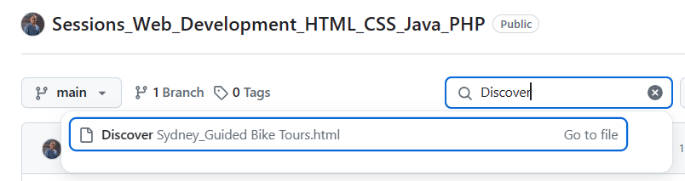
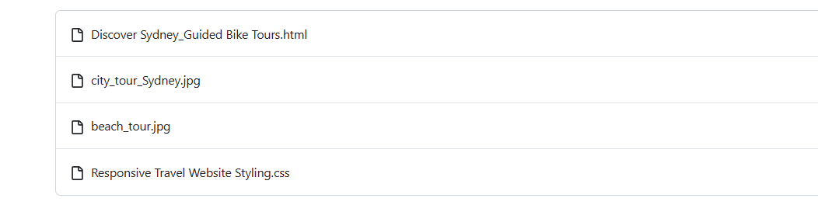
Weeks 6 - 7 Tutorial

Slide 100
<!DOCTYPE html>
<html lang="en">
<head>
<meta charset="UTF-8">
<meta name="viewport" content="width=device-width, initial-scale=1.0">
<title>Sydney Bike Tours</title>
<link rel="stylesheet" href="Responsive Travel Website Styling.css">
</head>
<body>
<header>
<div class="header-content">
<h1>Sydney Bike Tours</h1>
</div>
</header>
<nav>
<ul>
<li><a href="index.html">Home</a></li>
<li><a href="about.html">About Us</a></li>
<li><a href="contact.html">Contact</a></li>
</ul>
</nav>
This code creates a simple website for Sydney Bike Tours.

Slide 101
<!DOCTYPE html>
<html lang="en">
<head>
<meta charset="UTF-8">
<meta name="viewport" content="width=device-width, initial-scale=1.0">
<title>Sydney Bike Tours</title>
<link rel="stylesheet" href="Responsive Travel Website Styling.css">
</head>
<body>
<header>
<div class="header-content">
<h1>Sydney Bike Tours</h1>
</div>
</header>
<nav>
<ul>
<li><a href="index.html">Home</a></li>
<li><a href="about.html">About Us</a></li>
<li><a href="contact.html">Contact</a></li>
</ul>
</nav>
1. <!DOCTYPE html>
<!DOCTYPE html>
This tells the browser:
“This is an HTML5 webpage.”
2. Opening the HTML page
<html lang="en">
<html> starts the webpage.
lang="en" means the website is in English.

Slide 102
<!DOCTYPE html>
<html lang="en">
<head>
<meta charset="UTF-8">
<meta name="viewport" content="width=device-width, initial-scale=1.0">
<title>Sydney Bike Tours</title>
<link rel="stylesheet" href="Responsive Travel Website Styling.css">
</head>
<body>
<header>
<div class="header-content">
<h1>Sydney Bike Tours</h1>
</div>
</header>
<nav>
<ul>
<li><a href="index.html">Home</a></li>
<li><a href="about.html">About Us</a></li>
<li><a href="contact.html">Contact</a></li>
</ul>
</nav>
3. The <head> section
The <head> contains information about the webpage.
<head>
Character set
<meta charset="UTF-8">
This allows the webpage to display letters, symbols, and special characters correctly.

Slide 103
<!DOCTYPE html>
<html lang="en">
<head>
<meta charset="UTF-8">
<meta name="viewport" content="width=device-width, initial-scale=1.0">
<title>Sydney Bike Tours</title>
<link rel="stylesheet" href="Responsive Travel Website Styling.css">
</head>
<body>
<header>
<div class="header-content">
<h1>Sydney Bike Tours</h1>
</div>
</header>
<nav>
<ul>
<li><a href="index.html">Home</a></li>
<li><a href="about.html">About Us</a></li>
<li><a href="contact.html">Contact</a></li>
</ul>
</nav>
Responsive design
<meta name="viewport" content="width=device-width, initial-scale=1.0">
This helps the website look good on:
phones
tablets
computers
It makes the website responsive.

Slide 104
<!DOCTYPE html>
<html lang="en">
<head>
<meta charset="UTF-8">
<meta name="viewport" content="width=device-width, initial-scale=1.0">
<title>Sydney Bike Tours</title>
<link rel="stylesheet" href="Responsive Travel Website Styling.css">
</head>
<body>
<header>
<div class="header-content">
<h1>Sydney Bike Tours</h1>
</div>
</header>
<nav>
<ul>
<li><a href="index.html">Home</a></li>
<li><a href="about.html">About Us</a></li>
<li><a href="contact.html">Contact</a></li>
</ul>
</nav>
Website title
<title>Sydney Bike Tours</title>
This text appears:
on the browser tab
at the top of the page tab

Slide 105
<!DOCTYPE html>
<html lang="en">
<head>
<meta charset="UTF-8">
<meta name="viewport" content="width=device-width, initial-scale=1.0">
<title>Sydney Bike Tours</title>
<link rel="stylesheet" href="Responsive Travel Website Styling.css">
</head>
<body>
<header>
<div class="header-content">
<h1>Sydney Bike Tours</h1>
</div>
</header>
<nav>
<ul>
<li><a href="index.html">Home</a></li>
<li><a href="about.html">About Us</a></li>
<li><a href="contact.html">Contact</a></li>
</ul>
</nav>
Link to CSS file
<link rel="stylesheet" href="Responsive Travel Website Styling.css">
This connects the webpage to a CSS file.
CSS is used to:
add colours
change fonts
adjust layout
improve design

Slide 106
<!DOCTYPE html>
<html lang="en">
<head>
<meta charset="UTF-8">
<meta name="viewport" content="width=device-width, initial-scale=1.0">
<title>Sydney Bike Tours</title>
<link rel="stylesheet" href="Responsive Travel Website Styling.css">
</head>
<body>
<header>
<div class="header-content">
<h1>Sydney Bike Tours</h1>
</div>
</header>
<nav>
<ul>
<li><a href="index.html">Home</a></li>
<li><a href="about.html">About Us</a></li>
<li><a href="contact.html">Contact</a></li>
</ul>
</nav>
4. The <body> section
<body>
Everything inside the body is visible on the webpage.
5. Header section
<header>
The header is the top part of the website.

Slide 107
<!DOCTYPE html>
<html lang="en">
<head>
<meta charset="UTF-8">
<meta name="viewport" content="width=device-width, initial-scale=1.0">
<title>Sydney Bike Tours</title>
<link rel="stylesheet" href="Responsive Travel Website Styling.css">
</head>
<body>
<header>
<div class="header-content">
<h1>Sydney Bike Tours</h1>
</div>
</header>
<nav>
<ul>
<li><a href="index.html">Home</a></li>
<li><a href="about.html">About Us</a></li>
<li><a href="contact.html">Contact</a></li>
</ul>
</nav>
Website heading
<h1>Sydney Bike Tours</h1>
<h1> is the main heading.
It displays:
Sydney Bike Tours
6. Navigation menu
<nav>
This creates the menu bar.

Slide 108
<!DOCTYPE html>
<html lang="en">
<head>
<meta charset="UTF-8">
<meta name="viewport" content="width=device-width, initial-scale=1.0">
<title>Sydney Bike Tours</title>
<link rel="stylesheet" href="Responsive Travel Website Styling.css">
</head>
<body>
<header>
<div class="header-content">
<h1>Sydney Bike Tours</h1>
</div>
</header>
<nav>
<ul>
<li><a href="index.html">Home</a></li>
<li><a href="about.html">About Us</a></li>
<li><a href="contact.html">Contact</a></li>
</ul>
</nav>
Navigation list
<ul>
<ul> means unordered list.
Menu items
<li><a href="index.html">Home</a></li>
<li> = list item
<a> = hyperlink
This creates clickable links:
Home
About Us
Contact

Slide 109
<main>
<section class="tour-package">
<h2>City Tour</h2>
<img src="city_tour_Sydney.jpg" alt="Biking through Sydney city">
<p>Explore the city landmarks on two wheels.</p>
<a href="#" class="button">Book Now</a>
</section>
<section class="tour-package">
<h2>Beach Tour</h2>
<img src="beach_tour.jpg" alt="Biking at the beach">
<p>Feel the sea breeze as you ride along the coast.</p>
<a href="#" class="button">Learn More</a>
</section>
</main>
<footer>
<p>Contact us: <a href="mailto:info@sydneybiketours.com">info@sydneybiketours.com</a> | <a href="tel:+61234567890">+61 2 3456 7890</a></p>
</footer>
</body>
</html>
7. Main content area
<main>
This contains the main information on the webpage.
8. First tour package
<section class="tour-package">
A section groups related content together.
class="tour-package" is used for CSS styling.

Slide 110
<main>
<section class="tour-package">
<h2>City Tour</h2>
<img src="city_tour_Sydney.jpg" alt="Biking through Sydney city">
<p>Explore the city landmarks on two wheels.</p>
<a href="#" class="button">Book Now</a>
</section>
<section class="tour-package">
<h2>Beach Tour</h2>
<img src="beach_tour.jpg" alt="Biking at the beach">
<p>Feel the sea breeze as you ride along the coast.</p>
<a href="#" class="button">Learn More</a>
</section>
</main>
<footer>
<p>Contact us: <a href="mailto:info@sydneybiketours.com">info@sydneybiketours.com</a> | <a href="tel:+61234567890">+61 2 3456 7890</a></p>
</footer>
</body>
</html>
Tour title
<h2>City Tour</h2>
A smaller heading for the tour name.
Tour image
<img src="city_tour_Sydney.jpg" alt="Biking through Sydney city">
src = image file name
alt = text shown if the image cannot load

Slide 111
<main>
<section class="tour-package">
<h2>City Tour</h2>
<img src="city_tour_Sydney.jpg" alt="Biking through Sydney city">
<p>Explore the city landmarks on two wheels.</p>
<a href="#" class="button">Book Now</a>
</section>
<section class="tour-package">
<h2>Beach Tour</h2>
<img src="beach_tour.jpg" alt="Biking at the beach">
<p>Feel the sea breeze as you ride along the coast.</p>
<a href="#" class="button">Learn More</a>
</section>
</main>
<footer>
<p>Contact us: <a href="mailto:info@sydneybiketours.com">info@sydneybiketours.com</a> | <a href="tel:+61234567890">+61 2 3456 7890</a></p>
</footer>
</body>
</html>
Tour description
<p>Explore the city landmarks on two wheels.</p>
<p> means paragraph text.
Button link
<a href="#" class="button">Book Now</a>
This creates a button-like link.
href="#" means the link currently goes nowhere
class="button" allows CSS styling

Slide 112
<main>
<section class="tour-package">
<h2>City Tour</h2>
<img src="city_tour_Sydney.jpg" alt="Biking through Sydney city">
<p>Explore the city landmarks on two wheels.</p>
<a href="#" class="button">Book Now</a>
</section>
<section class="tour-package">
<h2>Beach Tour</h2>
<img src="beach_tour.jpg" alt="Biking at the beach">
<p>Feel the sea breeze as you ride along the coast.</p>
<a href="#" class="button">Learn More</a>
</section>
</main>
<footer>
<p>Contact us: <a href="mailto:info@sydneybiketours.com">info@sydneybiketours.com</a> | <a href="tel:+61234567890">+61 2 3456 7890</a></p>
</footer>
</body>
</html>
9. Second tour package
The second section works the same way.
It shows:
Beach Tour
beach image
description
“Learn More” button

Slide 113
<main>
<section class="tour-package">
<h2>City Tour</h2>
<img src="city_tour_Sydney.jpg" alt="Biking through Sydney city">
<p>Explore the city landmarks on two wheels.</p>
<a href="#" class="button">Book Now</a>
</section>
<section class="tour-package">
<h2>Beach Tour</h2>
<img src="beach_tour.jpg" alt="Biking at the beach">
<p>Feel the sea breeze as you ride along the coast.</p>
<a href="#" class="button">Learn More</a>
</section>
</main>
<footer>
<p>Contact us: <a href="mailto:info@sydneybiketours.com">info@sydneybiketours.com</a> | <a href="tel:+61234567890">+61 2 3456 7890</a></p>
</footer>
</body>
</html>
10. Footer section
<footer>
The footer is the bottom part of the webpage.
Contact information
<a href="mailto:info@sydneybiketours.com">
Creates an email link.
When clicked, it opens the user’s email app.

Slide 114
<main>
<section class="tour-package">
<h2>City Tour</h2>
<img src="city_tour_Sydney.jpg" alt="Biking through Sydney city">
<p>Explore the city landmarks on two wheels.</p>
<a href="#" class="button">Book Now</a>
</section>
<section class="tour-package">
<h2>Beach Tour</h2>
<img src="beach_tour.jpg" alt="Biking at the beach">
<p>Feel the sea breeze as you ride along the coast.</p>
<a href="#" class="button">Learn More</a>
</section>
</main>
<footer>
<p>Contact us: <a href="mailto:info@sydneybiketours.com">info@sydneybiketours.com</a> | <a href="tel:+61234567890">+61 2 3456 7890</a></p>
</footer>
</body>
</html>
Phone number link
<a href="tel:+61234567890">
Creates a clickable phone number.
Useful on mobile phones.
11. Closing tags
</body> </html>
These close the webpage structure.

Slide 115
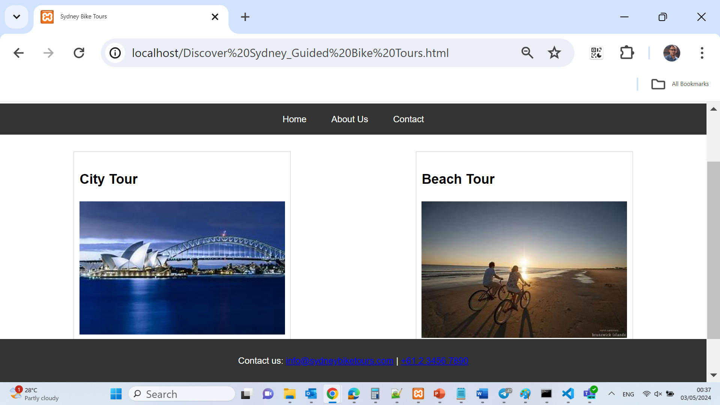
Weeks 6 - 7 Tutorial

Slide 116
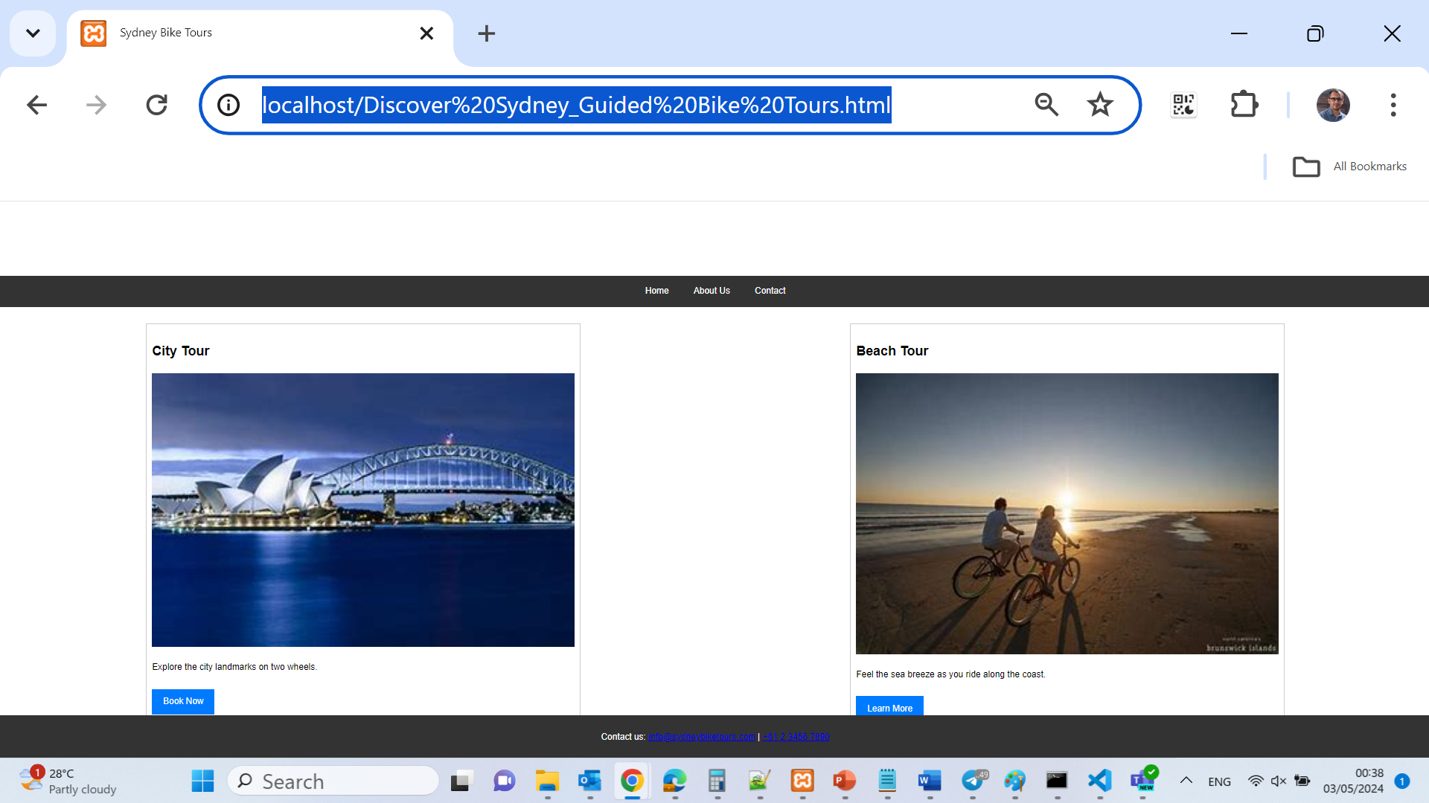
Weeks 6 - 7 Tutorial

Slide 117
Weeks 6 - 7 Tutorial
Project 1: Personalization of Spotted Wren Garden Center Website
1. Open and Rename Files:
Open .html and save it as hours.html.
Open HTM_E-6.css and save it as styles.css.
2. Update File Information:
In both hours.html and styles.css, update the comment section with your first and last names and today's date.
3. Add Font Link to HTML:
Visit Google Fonts and find the "Lato" font. Select the Normal 400 and Bold 700 styles and copy the link element.
Paste this link element in hours.html just before the existing stylesheet link.

Slide 118
Weeks 6 - 7 Tutorial
4. CSS Updates:
In styles.css, update the body style to use font-family: 'Lato', Arial, Helvetica, sans-serif; and set background-color: #fff;.
Set font-size: 12px; for the html element under reset styles.
Set font-size: 1.2em; for the p element under global styles.
For the h1 element in the header section, set font-size: 3em; and font-weight: bold;.
In the main content section, set font-size: 2.4em; and font-weight: bold; for the h2 element.
Wrap each day of the week and the colon in a span tag within hours.html and then style these spans to be bold and green in the CSS.

Slide 119
Weeks 6 - 7 Tutorial
5. Additional CSS Styles:
Set text color for p within the header to #f15a24.
Set the background color for .container to rgb(106, 194, 56).
Add a box shadow to .container with 0px offsets, 10px blur, and black color.
6. Preview and Validate:
Preview your webpage and compare with provided FIGURE 1.
Validate both your HTML and CSS using W3C validators to ensure no errors.

Slide 120
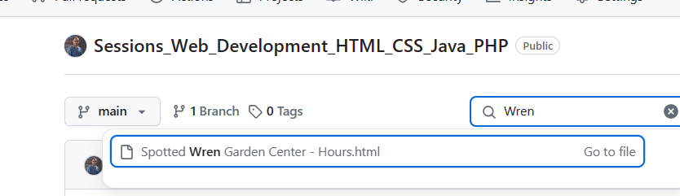
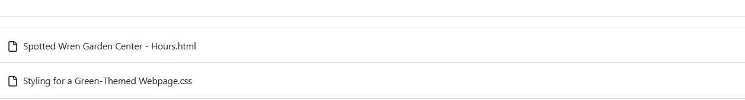
Weeks 6 - 7 Tutorial
This code creates a simple webpage for a garden center business called Spotted Wren Garden Center. It mainly shows the store’s summer opening hours and contact information.

Slide 121
<!DOCTYPE html>
<html lang="en">
<head>
<meta charset="UTF-8">
<title>Spotted Wren Garden Center - Hours</title>
<link href="https://fonts.googleapis.com/css2?family=Lato:wght@400;700&display=swap" rel="stylesheet">
<link rel="stylesheet" href="Styling for a Green-Themed Webpage.css">
</head>
<body>
<div class="container">
<header>
<h1>Spotted Wren Garden Center</h1>
<p style="color: #f15a24;">For your year-round garden and yard needs</p>
</header>
1. <!DOCTYPE html>
<!DOCTYPE html>
This tells the browser:
“This is an HTML5 webpage.”

Slide 122
<!DOCTYPE html>
<html lang="en">
<head>
<meta charset="UTF-8">
<title>Spotted Wren Garden Center - Hours</title>
<link href="https://fonts.googleapis.com/css2?family=Lato:wght@400;700&display=swap" rel="stylesheet">
<link rel="stylesheet" href="Styling for a Green-Themed Webpage.css">
</head>
<body>
<div class="container">
<header>
<h1>Spotted Wren Garden Center</h1>
<p style="color: #f15a24;">For your year-round garden and yard needs</p>
</header>
2. HTML opening tag
<html lang="en">
<html> starts the webpage
lang="en" means the webpage is written in English

Slide 123
<!DOCTYPE html>
<html lang="en">
<head>
<meta charset="UTF-8">
<title>Spotted Wren Garden Center - Hours</title>
<link href="https://fonts.googleapis.com/css2?family=Lato:wght@400;700&display=swap" rel="stylesheet">
<link rel="stylesheet" href="Styling for a Green-Themed Webpage.css">
</head>
<body>
<div class="container">
<header>
<h1>Spotted Wren Garden Center</h1>
<p style="color: #f15a24;">For your year-round garden and yard needs</p>
</header>
3. Head section
<head>
The <head> contains information about the webpage.

Slide 124
<!DOCTYPE html>
<html lang="en">
<head>
<meta charset="UTF-8">
<title>Spotted Wren Garden Center - Hours</title>
<link href="https://fonts.googleapis.com/css2?family=Lato:wght@400;700&display=swap" rel="stylesheet">
<link rel="stylesheet" href="Styling for a Green-Themed Webpage.css">
</head>
<body>
<div class="container">
<header>
<h1>Spotted Wren Garden Center</h1>
<p style="color: #f15a24;">For your year-round garden and yard needs</p>
</header>
Character encoding
<meta charset="UTF-8">
Allows the webpage to display text and symbols correctly.

Slide 125
<!DOCTYPE html>
<html lang="en">
<head>
<meta charset="UTF-8">
<title>Spotted Wren Garden Center - Hours</title>
<link href="https://fonts.googleapis.com/css2?family=Lato:wght@400;700&display=swap" rel="stylesheet">
<link rel="stylesheet" href="Styling for a Green-Themed Webpage.css">
</head>
<body>
<div class="container">
<header>
<h1>Spotted Wren Garden Center</h1>
<p style="color: #f15a24;">For your year-round garden and yard needs</p>
</header>
Webpage title
<title>Spotted Wren Garden Center - Hours</title>
This title appears:
on the browser tab
in search results

Slide 126
<!DOCTYPE html>
<html lang="en">
<head>
<meta charset="UTF-8">
<title>Spotted Wren Garden Center - Hours</title>
<link href="https://fonts.googleapis.com/css2?family=Lato:wght@400;700&display=swap" rel="stylesheet">
<link rel="stylesheet" href="Styling for a Green-Themed Webpage.css">
</head>
<body>
<div class="container">
<header>
<h1>Spotted Wren Garden Center</h1>
<p style="color: #f15a24;">For your year-round garden and yard needs</p>
</header>
4. Google Fonts link
<link href="https://fonts.googleapis.com/css2?family=Lato:wght@400;700&display=swap" rel="stylesheet">
This imports the Lato font from Google Fonts.
It makes the webpage text look nicer.
400 = normal font weight
700 = bold font weight

Slide 127
<!DOCTYPE html>
<html lang="en">
<head>
<meta charset="UTF-8">
<title>Spotted Wren Garden Center - Hours</title>
<link href="https://fonts.googleapis.com/css2?family=Lato:wght@400;700&display=swap" rel="stylesheet">
<link rel="stylesheet" href="Styling for a Green-Themed Webpage.css">
</head>
<body>
<div class="container">
<header>
<h1>Spotted Wren Garden Center</h1>
<p style="color: #f15a24;">For your year-round garden and yard needs</p>
</header>
5. CSS stylesheet
<link rel="stylesheet" href="Styling for a Green-Themed Webpage.css">
This connects the webpage to a CSS file.
The CSS file controls:
colours
layout
spacing
fonts
design

Slide 128
<!DOCTYPE html>
<html lang="en">
<head>
<meta charset="UTF-8">
<title>Spotted Wren Garden Center - Hours</title>
<link href="https://fonts.googleapis.com/css2?family=Lato:wght@400;700&display=swap" rel="stylesheet">
<link rel="stylesheet" href="Styling for a Green-Themed Webpage.css">
</head>
<body>
<div class="container">
<header>
<h1>Spotted Wren Garden Center</h1>
<p style="color: #f15a24;">For your year-round garden and yard needs</p>
</header>
6. Body section
<body>
Everything inside the body is shown on the webpage.

Slide 129
<!DOCTYPE html>
<html lang="en">
<head>
<meta charset="UTF-8">
<title>Spotted Wren Garden Center - Hours</title>
<link href="https://fonts.googleapis.com/css2?family=Lato:wght@400;700&display=swap" rel="stylesheet">
<link rel="stylesheet" href="Styling for a Green-Themed Webpage.css">
</head>
<body>
<div class="container">
<header>
<h1>Spotted Wren Garden Center</h1>
<p style="color: #f15a24;">For your year-round garden and yard needs</p>
</header>
7. Container div
<div class="container">
A <div> is used to group content together.
class="container" is usually used in CSS to:
center content
control page width
add spacing

Slide 130
<!DOCTYPE html>
<html lang="en">
<head>
<meta charset="UTF-8">
<title>Spotted Wren Garden Center - Hours</title>
<link href="https://fonts.googleapis.com/css2?family=Lato:wght@400;700&display=swap" rel="stylesheet">
<link rel="stylesheet" href="Styling for a Green-Themed Webpage.css">
</head>
<body>
<div class="container">
<header>
<h1>Spotted Wren Garden Center</h1>
<p style="color: #f15a24;">For your year-round garden and yard needs</p>
</header>
8. Header section
<header>
The top section of the webpage.
Main heading
<h1>Spotted Wren Garden Center</h1>
<h1> is the largest heading on the page.
It shows the business name.

Slide 131
<!DOCTYPE html>
<html lang="en">
<head>
<meta charset="UTF-8">
<title>Spotted Wren Garden Center - Hours</title>
<link href="https://fonts.googleapis.com/css2?family=Lato:wght@400;700&display=swap" rel="stylesheet">
<link rel="stylesheet" href="Styling for a Green-Themed Webpage.css">
</head>
<body>
<div class="container">
<header>
<h1>Spotted Wren Garden Center</h1>
<p style="color: #f15a24;">For your year-round garden and yard needs</p>
</header>
Small description
<p style="color: #f15a24;">
This is a paragraph with inline styling.
The text colour is set using a hex colour code:
#f15a24 = orange colour
The text says:
“For your year-round garden and yard needs”

Slide 132
<article>
<h2>Summer Hours</h2>
<p><span>Mon:</span> 8am — 8pm</p>
<p><span>Tue:</span> 8am — 8pm</p>
<p><span>Wed:</span> 8am — 5pm</p>
<p><span>Thu:</span> 8am — 8pm</p>
<p><span>Fri:</span> 8am — 8pm</p>
<p><span>Sat:</span> 9am — 6pm</p>
<p><span>Sun:</span> 11am — 6pm</p>
</article>
<footer>
<p>548 N. 58th St. • Omaha, NE 68132 • (402) 555-9736</p>
</footer>
</div>
</body>
</html>
9. Article section
<article>
The <article> contains the main information.
In this case:
business opening hours

Slide 133
<article>
<h2>Summer Hours</h2>
<p><span>Mon:</span> 8am — 8pm</p>
<p><span>Tue:</span> 8am — 8pm</p>
<p><span>Wed:</span> 8am — 5pm</p>
<p><span>Thu:</span> 8am — 8pm</p>
<p><span>Fri:</span> 8am — 8pm</p>
<p><span>Sat:</span> 9am — 6pm</p>
<p><span>Sun:</span> 11am — 6pm</p>
</article>
<footer>
<p>548 N. 58th St. • Omaha, NE 68132 • (402) 555-9736</p>
</footer>
</div>
</body>
</html>
Section heading
<h2>Summer Hours</h2>
A smaller heading for the timetable section.

Slide 134
<article>
<h2>Summer Hours</h2>
<p><span>Mon:</span> 8am — 8pm</p>
<p><span>Tue:</span> 8am — 8pm</p>
<p><span>Wed:</span> 8am — 5pm</p>
<p><span>Thu:</span> 8am — 8pm</p>
<p><span>Fri:</span> 8am — 8pm</p>
<p><span>Sat:</span> 9am — 6pm</p>
<p><span>Sun:</span> 11am — 6pm</p>
</article>
<footer>
<p>548 N. 58th St. • Omaha, NE 68132 • (402) 555-9736</p>
</footer>
</div>
</body>
</html>
10. Opening hours
Example:
<p><span>Mon:</span> 8am — 8pm</p>
This creates a paragraph showing:
the day
the opening and closing times
<span> is used to style part of the text separately with CSS.
The code repeats this for every day of the week.

Slide 135
<article>
<h2>Summer Hours</h2>
<p><span>Mon:</span> 8am — 8pm</p>
<p><span>Tue:</span> 8am — 8pm</p>
<p><span>Wed:</span> 8am — 5pm</p>
<p><span>Thu:</span> 8am — 8pm</p>
<p><span>Fri:</span> 8am — 8pm</p>
<p><span>Sat:</span> 9am — 6pm</p>
<p><span>Sun:</span> 11am — 6pm</p>
</article>
<footer>
<p>548 N. 58th St. • Omaha, NE 68132 • (402) 555-9736</p>
</footer>
</div>
</body>
</html>
11. Footer section
<footer>
The footer is the bottom part of the webpage.
Contact details
<p>548 N. 58th St. • Omaha, NE 68132 • (402) 555-9736</p>
Displays:
address
city and postcode
phone number

Slide 136
<article>
<h2>Summer Hours</h2>
<p><span>Mon:</span> 8am — 8pm</p>
<p><span>Tue:</span> 8am — 8pm</p>
<p><span>Wed:</span> 8am — 5pm</p>
<p><span>Thu:</span> 8am — 8pm</p>
<p><span>Fri:</span> 8am — 8pm</p>
<p><span>Sat:</span> 9am — 6pm</p>
<p><span>Sun:</span> 11am — 6pm</p>
</article>
<footer>
<p>548 N. 58th St. • Omaha, NE 68132 • (402) 555-9736</p>
</footer>
</div>
</body>
</html>
12. Closing tags
</div> </body> </html>
These close the webpage structure properly.

Slide 137
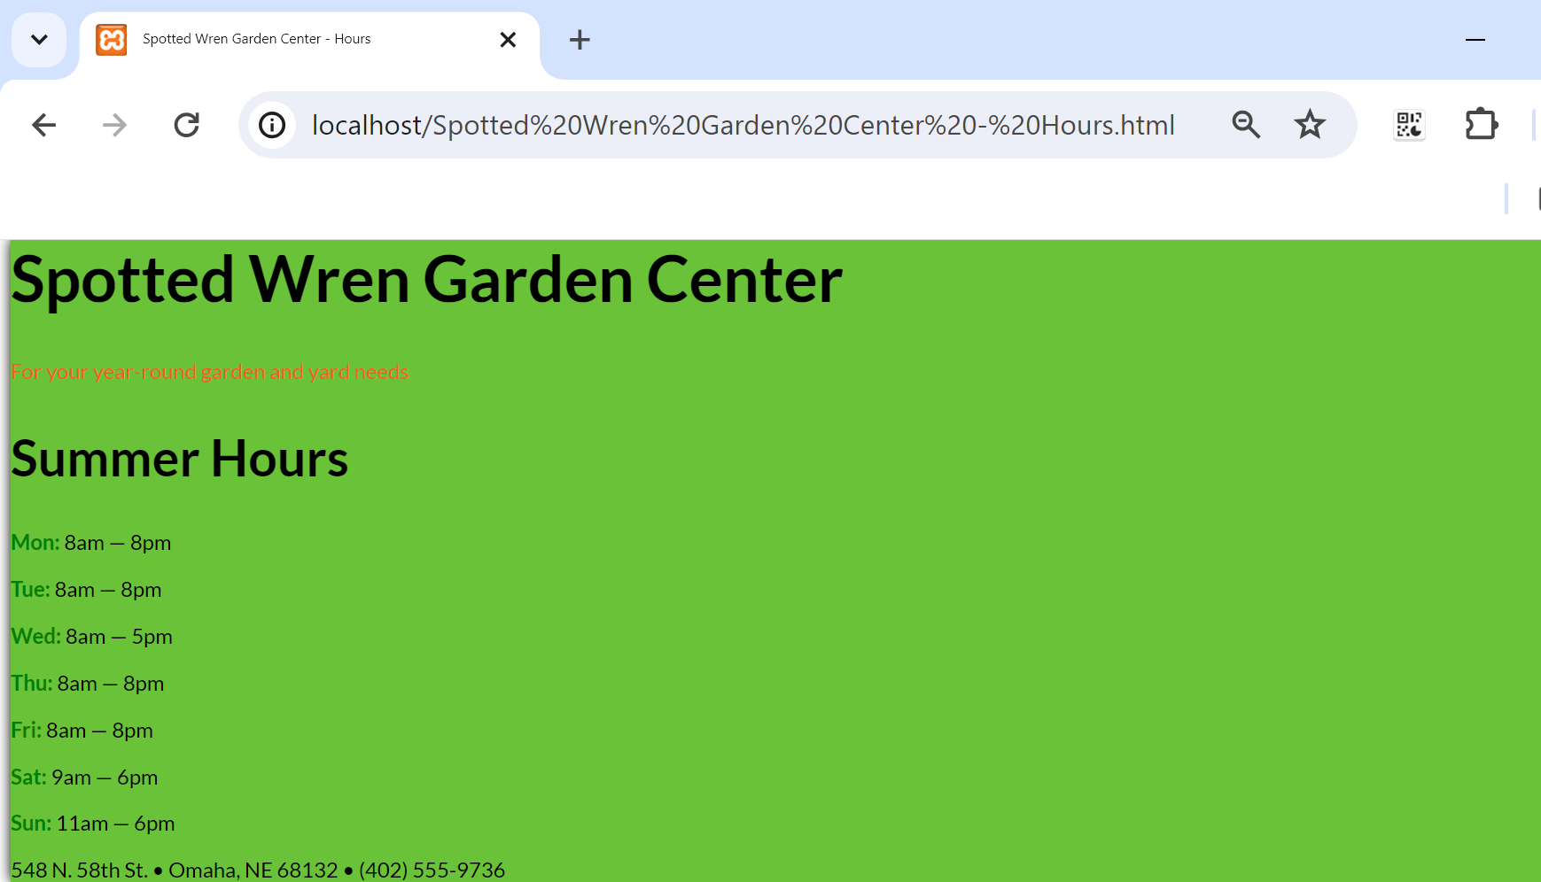
Weeks 6 - 7 Tutorial
The page is dedicated to displaying the operating hours of the "Spotted Wren Garden Center." This is both concise and informative, making it easy for users and search engines to understand the content of the page quickly.

Slide 138
Weeks 6 - 7 Tutorial
Challenge 1: Styling Murfreesboro Regional Soccer League Website
1. Open and Rename Files:
Open HTM_E-7.html and save it as index.html.
Open HTM_E-8.css and save it as styles.css.

Slide 139
Weeks 6 - 7 Tutorial
2. CSS Modifications:
Set font-size: 14px; for the html element.
In the body section, set font-family: Arial, Helvetica, sans-serif; and font-size for p elements to 1.2em;.
Set the header background to rgb(140, 198, 63); and style the h1 with a font size of 2em, a text shadow, and a font stack including Georgia and Times New Roman.
Italicize the p element in the header.

Slide 140
Weeks 6 - 7 Tutorial
3. Additional Content and Styling:
Set a different background for the aside, footer, and main content areas.
Adjust font sizes and weights where necessary, particularly in the aside and footer for emphasis.
4. Final Steps:
Save your changes and open index.html to compare with FIGURE 2.
Add print styles at the bottom of your CSS for proper print formatting.
5. Preview and Validation:
Reload the page, check the print preview against FIGURE 3.
Validate HTML and CSS and fix any identified issues.
Additional Recommendations
Use developer tools to experiment with different layouts and font stacks.
Engage in peer reviews for feedback on your design choices.

Slide 141
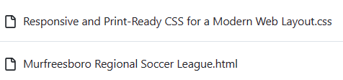
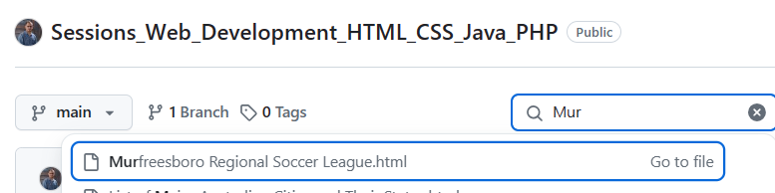
This code creates a simple webpage for a soccer league called Murfreesboro Soccer. The page includes:
a title
a short message
upcoming match information
contact details

Slide 142
<!DOCTYPE html>
<html lang="en">
<head>
<meta charset="UTF-8">
<title>Murfreesboro Regional Soccer League</title>
<link rel="stylesheet" href="Responsive and Print-Ready CSS for a Modern Web Layout.css">
</head>
<body>
<header>
<h1 style="text-shadow: 0px 0px 10px ivory;">Murfreesboro Soccer</h1>
<p style="font-style: italic;">Join our league today!</p>
</header>
<aside>
<h2>Upcoming Matches</h2>
<p>Check out the latest match schedules!</p>
</aside>
<footer>
<p>Contact us: soccer@murfreesboro.org</p>
</footer>
</body>
</html>
1. <!DOCTYPE html>
<!DOCTYPE html>
This tells the browser:
“This webpage uses HTML5.”

Slide 143
<!DOCTYPE html>
<html lang="en">
<head>
<meta charset="UTF-8">
<title>Murfreesboro Regional Soccer League</title>
<link rel="stylesheet" href="Responsive and Print-Ready CSS for a Modern Web Layout.css">
</head>
<body>
<header>
<h1 style="text-shadow: 0px 0px 10px ivory;">Murfreesboro Soccer</h1>
<p style="font-style: italic;">Join our league today!</p>
</header>
<aside>
<h2>Upcoming Matches</h2>
<p>Check out the latest match schedules!</p>
</aside>
<footer>
<p>Contact us: soccer@murfreesboro.org</p>
</footer>
</body>
</html>
2. HTML opening tag
<html lang="en">
<html> starts the webpage
lang="en" means the page is written in English

Slide 144
<!DOCTYPE html>
<html lang="en">
<head>
<meta charset="UTF-8">
<title>Murfreesboro Regional Soccer League</title>
<link rel="stylesheet" href="Responsive and Print-Ready CSS for a Modern Web Layout.css">
</head>
<body>
<header>
<h1 style="text-shadow: 0px 0px 10px ivory;">Murfreesboro Soccer</h1>
<p style="font-style: italic;">Join our league today!</p>
</header>
<aside>
<h2>Upcoming Matches</h2>
<p>Check out the latest match schedules!</p>
</aside>
<footer>
<p>Contact us: soccer@murfreesboro.org</p>
</footer>
</body>
</html>
3. Head section
<head>
The <head> contains webpage information that is not directly shown on the page.

Slide 145
<!DOCTYPE html>
<html lang="en">
<head>
<meta charset="UTF-8">
<title>Murfreesboro Regional Soccer League</title>
<link rel="stylesheet" href="Responsive and Print-Ready CSS for a Modern Web Layout.css">
</head>
<body>
<header>
<h1 style="text-shadow: 0px 0px 10px ivory;">Murfreesboro Soccer</h1>
<p style="font-style: italic;">Join our league today!</p>
</header>
<aside>
<h2>Upcoming Matches</h2>
<p>Check out the latest match schedules!</p>
</aside>
<footer>
<p>Contact us: soccer@murfreesboro.org</p>
</footer>
</body>
</html>
Character encoding
<meta charset="UTF-8">
Allows the webpage to correctly display text and symbols.

Slide 146
<!DOCTYPE html>
<html lang="en">
<head>
<meta charset="UTF-8">
<title>Murfreesboro Regional Soccer League</title>
<link rel="stylesheet" href="Responsive and Print-Ready CSS for a Modern Web Layout.css">
</head>
<body>
<header>
<h1 style="text-shadow: 0px 0px 10px ivory;">Murfreesboro Soccer</h1>
<p style="font-style: italic;">Join our league today!</p>
</header>
<aside>
<h2>Upcoming Matches</h2>
<p>Check out the latest match schedules!</p>
</aside>
<footer>
<p>Contact us: soccer@murfreesboro.org</p>
</footer>
</body>
</html>
Page title
<title>Murfreesboro Regional Soccer League</title>
This text appears:
on the browser tab
in search engine results

Slide 147
<!DOCTYPE html>
<html lang="en">
<head>
<meta charset="UTF-8">
<title>Murfreesboro Regional Soccer League</title>
<link rel="stylesheet" href="Responsive and Print-Ready CSS for a Modern Web Layout.css">
</head>
<body>
<header>
<h1 style="text-shadow: 0px 0px 10px ivory;">Murfreesboro Soccer</h1>
<p style="font-style: italic;">Join our league today!</p>
</header>
<aside>
<h2>Upcoming Matches</h2>
<p>Check out the latest match schedules!</p>
</aside>
<footer>
<p>Contact us: soccer@murfreesboro.org</p>
</footer>
</body>
</html>
CSS stylesheet
<link rel="stylesheet" href="Responsive and Print-Ready CSS for a Modern Web Layout.css">
This connects the webpage to a CSS file.
The CSS file controls:
colours
layout
spacing
fonts
responsive design
print-friendly formatting

Slide 148
<!DOCTYPE html>
<html lang="en">
<head>
<meta charset="UTF-8">
<title>Murfreesboro Regional Soccer League</title>
<link rel="stylesheet" href="Responsive and Print-Ready CSS for a Modern Web Layout.css">
</head>
<body>
<header>
<h1 style="text-shadow: 0px 0px 10px ivory;">Murfreesboro Soccer</h1>
<p style="font-style: italic;">Join our league today!</p>
</header>
<aside>
<h2>Upcoming Matches</h2>
<p>Check out the latest match schedules!</p>
</aside>
<footer>
<p>Contact us: soccer@murfreesboro.org</p>
</footer>
</body>
</html>
4. Body section
<body>
Everything inside the body is visible on the webpage.

Slide 149
<!DOCTYPE html>
<html lang="en">
<head>
<meta charset="UTF-8">
<title>Murfreesboro Regional Soccer League</title>
<link rel="stylesheet" href="Responsive and Print-Ready CSS for a Modern Web Layout.css">
</head>
<body>
<header>
<h1 style="text-shadow: 0px 0px 10px ivory;">Murfreesboro Soccer</h1>
<p style="font-style: italic;">Join our league today!</p>
</header>
<aside>
<h2>Upcoming Matches</h2>
<p>Check out the latest match schedules!</p>
</aside>
<footer>
<p>Contact us: soccer@murfreesboro.org</p>
</footer>
</body>
</html>
5. Header section
<header>
The header is the top part of the webpage.

Slide 150
<!DOCTYPE html>
<html lang="en">
<head>
<meta charset="UTF-8">
<title>Murfreesboro Regional Soccer League</title>
<link rel="stylesheet" href="Responsive and Print-Ready CSS for a Modern Web Layout.css">
</head>
<body>
<header>
<h1 style="text-shadow: 0px 0px 10px ivory;">Murfreesboro Soccer</h1>
<p style="font-style: italic;">Join our league today!</p>
</header>
<aside>
<h2>Upcoming Matches</h2>
<p>Check out the latest match schedules!</p>
</aside>
<footer>
<p>Contact us: soccer@murfreesboro.org</p>
</footer>
</body>
</html>
Main heading
<h1 style="text-shadow: 0px 0px 10px ivory;">
This creates the main title:
Murfreesboro Soccer

Slide 151
<!DOCTYPE html>
<html lang="en">
<head>
<meta charset="UTF-8">
<title>Murfreesboro Regional Soccer League</title>
<link rel="stylesheet" href="Responsive and Print-Ready CSS for a Modern Web Layout.css">
</head>
<body>
<header>
<h1 style="text-shadow: 0px 0px 10px ivory;">Murfreesboro Soccer</h1>
<p style="font-style: italic;">Join our league today!</p>
</header>
<aside>
<h2>Upcoming Matches</h2>
<p>Check out the latest match schedules!</p>
</aside>
<footer>
<p>Contact us: soccer@murfreesboro.org</p>
</footer>
</body>
</html>
Inline CSS styling
style="text-shadow: 0px 0px 10px ivory;"
This adds a glowing shadow effect behind the text.
0px 0px = shadow position
10px = blur amount
ivory = shadow colour

Slide 152
<!DOCTYPE html>
<html lang="en">
<head>
<meta charset="UTF-8">
<title>Murfreesboro Regional Soccer League</title>
<link rel="stylesheet" href="Responsive and Print-Ready CSS for a Modern Web Layout.css">
</head>
<body>
<header>
<h1 style="text-shadow: 0px 0px 10px ivory;">Murfreesboro Soccer</h1>
<p style="font-style: italic;">Join our league today!</p>
</header>
<aside>
<h2>Upcoming Matches</h2>
<p>Check out the latest match schedules!</p>
</aside>
<footer>
<p>Contact us: soccer@murfreesboro.org</p>
</footer>
</body>
</html>
Italic text
<p style="font-style: italic;">Join our league today!</p>
This creates a paragraph in italic style.
The message encourages people to join the soccer league.

Slide 153
<!DOCTYPE html>
<html lang="en">
<head>
<meta charset="UTF-8">
<title>Murfreesboro Regional Soccer League</title>
<link rel="stylesheet" href="Responsive and Print-Ready CSS for a Modern Web Layout.css">
</head>
<body>
<header>
<h1 style="text-shadow: 0px 0px 10px ivory;">Murfreesboro Soccer</h1>
<p style="font-style: italic;">Join our league today!</p>
</header>
<aside>
<h2>Upcoming Matches</h2>
<p>Check out the latest match schedules!</p>
</aside>
<footer>
<p>Contact us: soccer@murfreesboro.org</p>
</footer>
</body>
</html>
6. Aside section
<aside>
The <aside> section contains extra or side information.
In this case:
upcoming matches information

Slide 154
<!DOCTYPE html>
<html lang="en">
<head>
<meta charset="UTF-8">
<title>Murfreesboro Regional Soccer League</title>
<link rel="stylesheet" href="Responsive and Print-Ready CSS for a Modern Web Layout.css">
</head>
<body>
<header>
<h1 style="text-shadow: 0px 0px 10px ivory;">Murfreesboro Soccer</h1>
<p style="font-style: italic;">Join our league today!</p>
</header>
<aside>
<h2>Upcoming Matches</h2>
<p>Check out the latest match schedules!</p>
</aside>
<footer>
<p>Contact us: soccer@murfreesboro.org</p>
</footer>
</body>
</html>
side heading
<h2>Upcoming Matches</h2>
A smaller heading for the matches section.
Aside paragraph
<p>Check out the latest match schedules!</p>
This tells visitors to look at the match schedule.

Slide 155
<!DOCTYPE html>
<html lang="en">
<head>
<meta charset="UTF-8">
<title>Murfreesboro Regional Soccer League</title>
<link rel="stylesheet" href="Responsive and Print-Ready CSS for a Modern Web Layout.css">
</head>
<body>
<header>
<h1 style="text-shadow: 0px 0px 10px ivory;">Murfreesboro Soccer</h1>
<p style="font-style: italic;">Join our league today!</p>
</header>
<aside>
<h2>Upcoming Matches</h2>
<p>Check out the latest match schedules!</p>
</aside>
<footer>
<p>Contact us: soccer@murfreesboro.org</p>
</footer>
</body>
</html>
7. Footer section
<footer>
The footer is the bottom part of the webpage.
Contact information
<p>Contact us: soccer@murfreesboro.org</p>
Displays the contact email address for the soccer league.

Slide 156
<!DOCTYPE html>
<html lang="en">
<head>
<meta charset="UTF-8">
<title>Murfreesboro Regional Soccer League</title>
<link rel="stylesheet" href="Responsive and Print-Ready CSS for a Modern Web Layout.css">
</head>
<body>
<header>
<h1 style="text-shadow: 0px 0px 10px ivory;">Murfreesboro Soccer</h1>
<p style="font-style: italic;">Join our league today!</p>
</header>
<aside>
<h2>Upcoming Matches</h2>
<p>Check out the latest match schedules!</p>
</aside>
<footer>
<p>Contact us: soccer@murfreesboro.org</p>
</footer>
</body>
</html>
8. Closing tags
</body> </html>
These close the webpage structure properly.

Slide 157
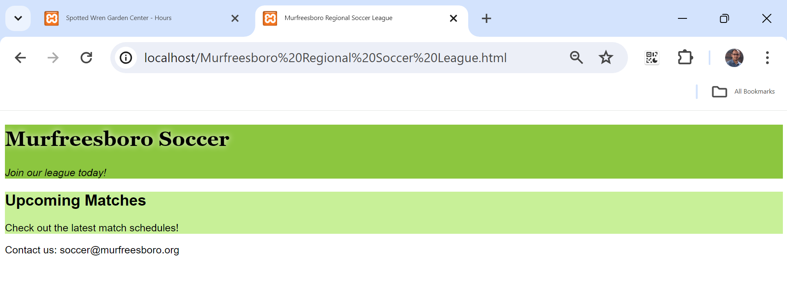
Weeks 6 - 7 Tutorial
The website specifically target potential participants and fans of the soccer league in Murfreesboro.

Slide 158
Weeks 6 - 7 Tutorial
Lecture 6 covers more CSS basics with a focus on enhancing web design through advanced styling techniques. The lecture covers various aspects of CSS:
Web Fonts: The lecture discusses the importance of consistent font display across different user devices. Strategies include using font stacks, generic font families, and downloadable fonts with the @font-face rule to ensure fonts are uniform across platforms.
Font Properties: It covers how to declare font families, customize fonts from sources like Google Fonts, and adjust font size and line height for better readability and aesthetic appeal.
Text Styling: Techniques to implement bold and italics using CSS properties like font-weight and font-style, often with the span element to target specific text sections.

Slide 159
Weeks 6 - 7 Tutorial
Pseudo-Elements: The use of CSS pseudo-elements such as :first-letter and :first-line to style specific parts of text, such as creating a drop cap effect.
Color Specification: Explains different methods to specify text and background colors using names, hexadecimal, RGB, and HSL values.
Shadows: Introduces text-shadow and box-shadow properties to add depth to text and elements, enhancing visual hierarchy.
Media Queries: Discusses the use of media queries to tailor content to different devices, ensuring a responsive and tailored user experience.

Slide 160
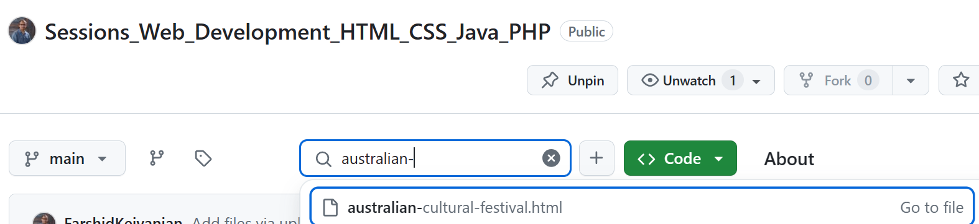
Weeks 6 - 7 Tutorial
These CSS basics are crucial for web designers to create visually appealing and functionally robust web pages.
Next Practical Example: Web Design for an Australian Cultural Festival
Let's apply these concepts to design a webpage for an Australian cultural festival. The page will feature custom fonts, color schemes reflective of the Australian landscape, and responsive design elements tailored for various devices.
HTML and CSS Code:

Slide 161
Weeks 6 - 7 Tutorial
This example uses a custom Google Font, a color palette inspired by Australia's natural beauty, shadows to enhance text readability against bright colors, and a media query to ensure the content looks great on both desktops and mobile devices.

Slide 162
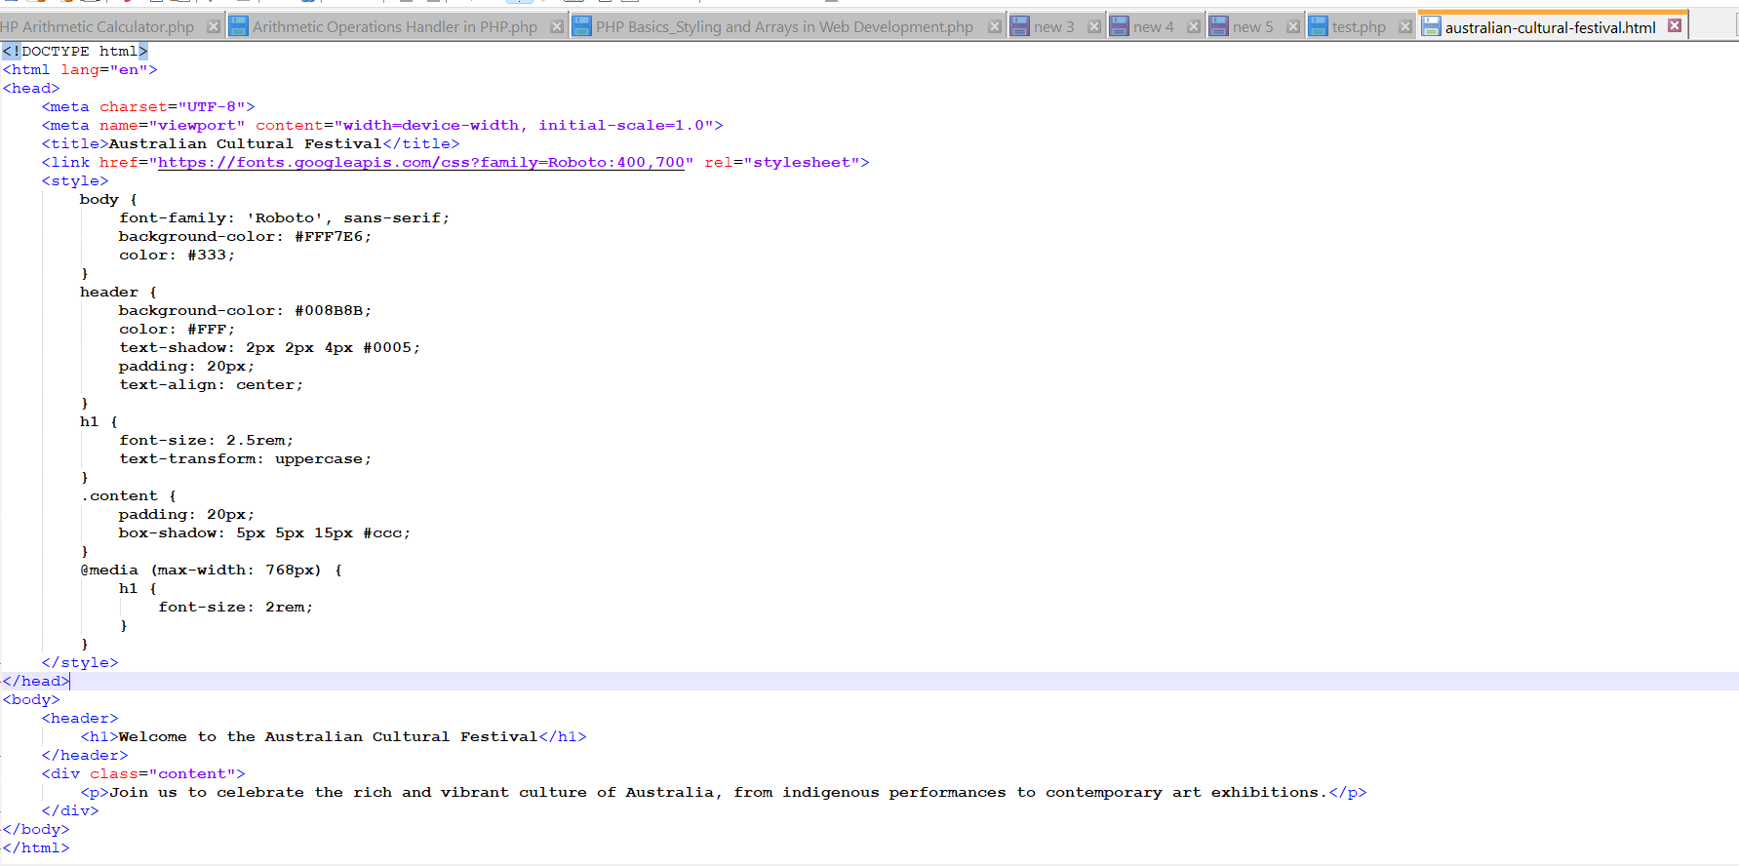
Weeks 6 - 7 Tutorial
<meta name="viewport" content="width=device-width, initial-scale=1.0">:
This viewport meta tag ensures the page is scaled correctly on all devices, especially on mobiles. It sets the width of the viewport to match the device’s width and initializes the zoom level to 1.0.

Slide 163
Weeks 6 - 7 Tutorial
<link href="https://fonts.googleapis.com/css?family=Roboto:400,700" rel="stylesheet">:
This link imports the Roboto font from Google Fonts, including the normal (400) and bold (700) font weights.

Slide 164
Weeks 6 - 7 Tutorial
<style>:
This tag contains the CSS used to style the HTML content.
body:
Sets the font family to 'Roboto', with a fallback to any available sans-serif font if Roboto isn't loaded. The background color is set to a light cream (#FFF7E6), and the text color to dark grey (#333).

Slide 165
Weeks 6 - 7 Tutorial
header:
Styles the <header> element with a teal background color (#008B8B), white text color (#FFF), and a text shadow that creates a soft dark shadow around the text, improving readability on the colored background. Padding is added for spacing, and the text is centered.

Slide 166
Weeks 6 - 7 Tutorial
h1:
The main heading is styled with a font size of 2.5 rem (rem units are relative to the root html element size), and the text is transformed to uppercase for emphasis.

Slide 167
Weeks 6 - 7 Tutorial
.content:
This class styles any element it is applied to (here, a <div>), adding padding for spacing and a box shadow for a 3D effect, making the element appear elevated from the rest of the content.

Slide 168
Weeks 6 - 7 Tutorial
@media (max-width: 768px):
This is a media query that applies styles based on the condition described. If the viewport width is 768 pixels or less (common for tablets and mobile devices), the styles inside the query are applied.
Inside this media query, the font size of <h1> is reduced to 2 rem, making it more appropriate for smaller screens.

Slide 169
Weeks 6 - 7 Tutorial
HTML Body Content
<body>:
This tag encompasses all the visible content of the HTML document.
<header>:
Contains the main heading of the page wrapped in an <h1> tag, greeting visitors and indicating the theme of the content.
<div class="content">:
A division or section in HTML that contains a paragraph describing the event, styled with the class .content for specific styling as defined in the CSS.

Slide 170
Weeks 6 - 7 Tutorial
This markup and styling collectively create a responsive, aesthetically pleasing webpage for promoting the Australian Cultural Festival, utilizing advanced CSS properties and HTML structure techniques taught in the lecture.

Slide 171
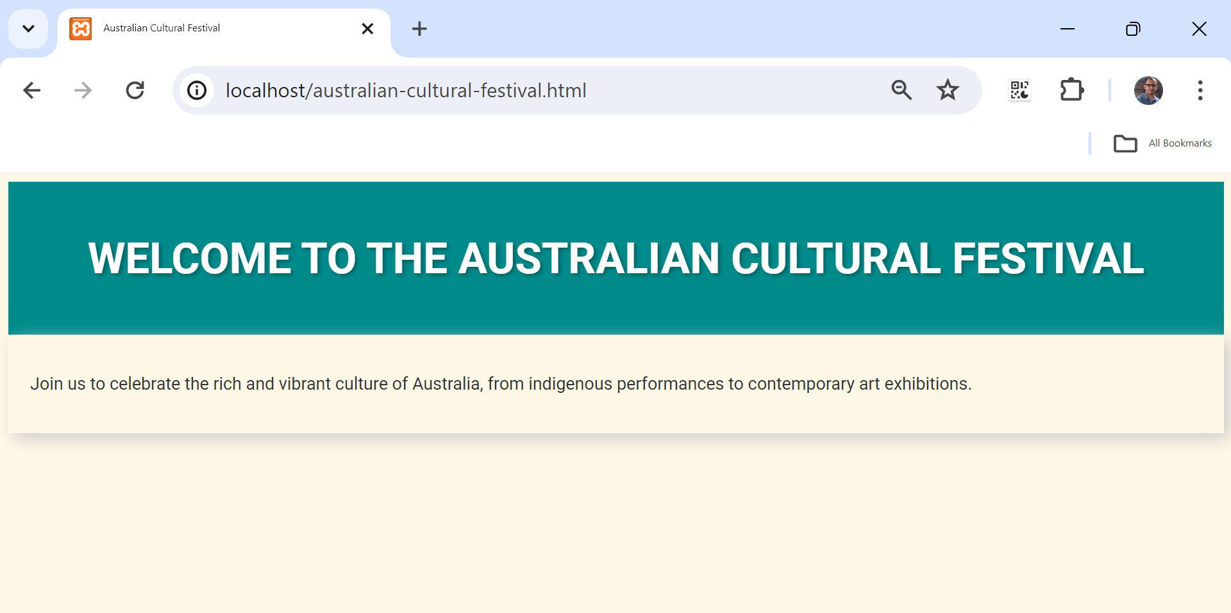
Weeks 6 - 7 Tutorial

Slide 172
Weeks 6 - 7 Tutorial
Task 2: Update HTML Document
Title Update: We'll add a title.
Footer Update: Update the footer to include your name and today's date.
Task 3: Update CSS Document
Comment Update: Modify the CSS file comment to include your name and today's date.

Slide 173
Weeks 6 - 7 Tutorial
Task 4 to 7: Add Semantic Elements and Content
Section, Article, and Aside: Add a section element with two article elements inside, and update the aside element positioning within the HTML structure.
Task 8: CSS Styling
Add CSS Rules: Add style rules for section, article, and aside elements.
Task 11 & 12: Validate HTML and CSS
Validate HTML and CSS using the W3C validator

Slide 174
Weeks 6 - 7 Tutorial
Task 14: Discuss CSS Float Property
Explanation of float property and alternative methods such as Flexbox or Grid.
We'll start by making the necessary changes to the HTML and CSS files and then provide the updated code. Here is the revised HTML code:

Slide 175
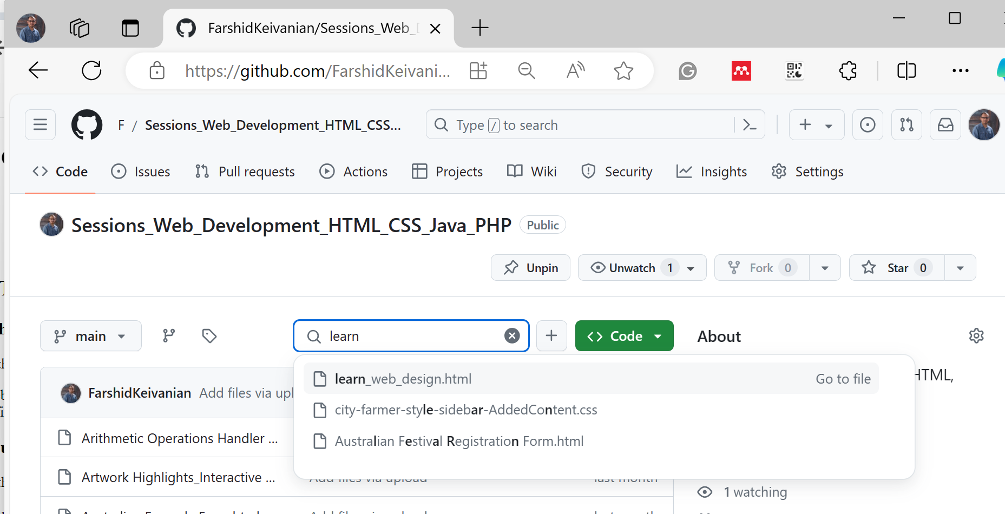
Weeks 6 - 7 Tutorial
Learn Webpage Design

Slide 176
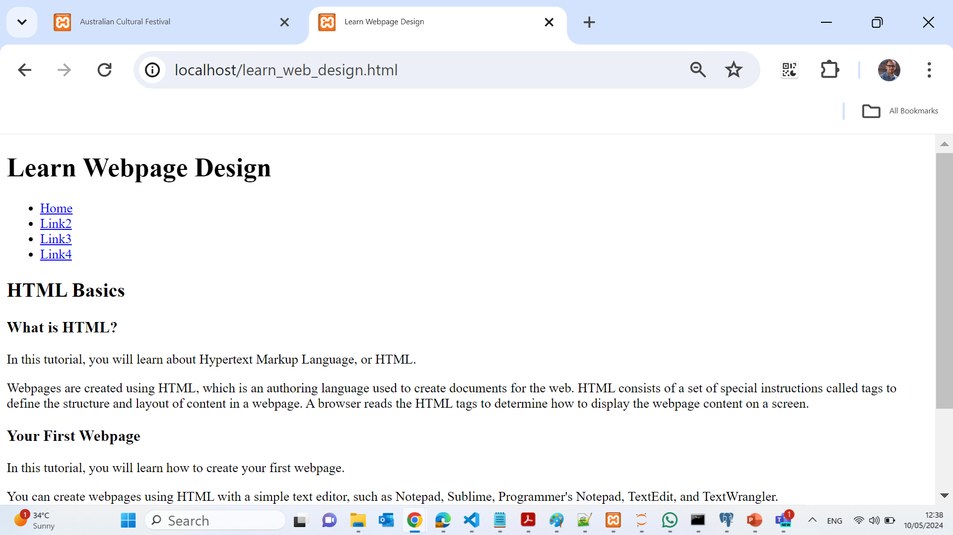
Weeks 6 - 7 Tutorial
Learn Webpage Design
Please provide your name and today's date to personalize the comments in the HTML and CSS files and let's discuss the float property as per task 14 after updating the CSS.

Slide 177
Lab 3 Practice
Question 1
What file must you open and save as hours.html in Project 1?
A. .html B. HTM_E-7.html C. apply07.html D. index.html
The correct file is .html because the project instructions specifically require students to open this starter HTML file and then save it under the new name hours.html.
Option B (HTM_E-7.html) is a different exercise file.
Option C (apply07.html) is not the required starter template.
Option D (index.html) is a common webpage filename, but it is not mentioned in the project instructions.
Therefore, .html is the best and correct answer.

Slide 178
Lab 3 Practice
Question 2
Which CSS file must be opened and saved as styles.css in Project 1?
A. HTM_E-6.css B. HTM_E-8.css C. applystyles07.css D. main.css
The project directions state that the CSS starter file to be used is HTM_E-6.css, which must then be saved as styles.css.
Option B (HTM_E-8.css) belongs to another activity.
Option C (applystyles07.css) is unrelated to this project setup.
Option D (main.css) is a generic stylesheet name and not the required file.
So, HTM_E-6.css is the correct choice.

Slide 179
Lab 3 Practice
Question 3
Where must your name and today’s date be added?
A. In the first comment section of both HTML and CSS files B. Only in the footer C. Only inside D. In a separate notes file
Most web development lab projects require students to place identifying information such as their name and date inside the first comment section of both the HTML and CSS files. This helps instructors verify authorship and maintain proper documentation.
Option B is incorrect because the footer is part of the webpage content, not file documentation.
Option C is incomplete and unclear.
Option D is incorrect because the instructions specifically require the information inside the project files themselves.

Slide 180
Lab 3 Practice
Question 4
Which Google Font must be added to hours.html?
A. Lato B. Roboto C. Open Sans D. Georgia
The required Google Font for the webpage is Lato. This font is commonly chosen because it is clean, modern, and easy to read on websites.
Roboto and Open Sans are also popular web fonts, but they were not specified in this project instructions.
Georgia is not a Google Font; it is a standard serif font included with many operating systems.
Thus, Lato is the correct and best answer.

Slide 181
Lab 3 Practice
Question 5
Where should the Google Fonts element be pasted?
A. Before the link to the stylesheet B. After the closing tag C. Inside the footer D. At the bottom of the CSS file
The Google Fonts <link> element should be placed before the stylesheet link in the HTML <head> section. This ensures the font loads first so the CSS file can correctly apply the font styles to the webpage elements.
Option B is incorrect because placing it after the closing tag would break proper HTML structure.
Option C is wrong because fonts are loaded in the document head, not inside the footer.
Option D is incorrect because Google Fonts are linked through HTML, not pasted into the bottom of the CSS file.

Slide 182
Lab 3 Practice
Question 6
What background color must be set for the body element in styles.css?
A. #fff B. #000 C. #f15a24 D. rgb(106,194,56)
The color code #fff represents white in hexadecimal CSS color notation. The project instructions require the webpage body background to be white for a clean and readable design.
#000 represents black, which would create a dark background.
#f15a24 is an orange shade, not the required background color.
rgb(106,194,56) is a green color value.
Thus, #fff is the best and correct answer.

Slide 183
Lab 3 Practice
Question 7
What font size must be set for the html element in the reset styles section?
A. 12px B. 10px C. 16px D. 1em
The reset styles section sets a consistent base font size for the webpage. In this project, the required font size for the html element is 12px. This provides a standard starting point for scaling text sizes throughout the site.
10px is smaller than the required size.
16px is the browser default in many cases, but not the specified project value.
1em is a relative measurement, not the exact required size.

Slide 184
Lab 3 Practice
Question 8
What font size must be set for p elements in the global styles section?
A. 1.2em B. 14px C. 2em D. 0.8em
The project instructions specify that paragraph (p) elements should use a font size of 1.2em in the global styles section. Using em units allows text to scale relative to the base font size, improving responsiveness and readability.
14px is a fixed size and not the required value.
2em would make the text much larger than intended.
0.8em would reduce the paragraph size and make it harder to read.
So, 1.2em is the best and correct answer.

Slide 185
Lab 3 Practice
Question 9
What font size must be set for h1 in the header section?
A. 3em B. 1.5em C. 2em D. 4em
The project instructions specify that the h1 heading in the header section should use a font size of 3em. This size makes the main heading large and prominent, helping it stand out as the primary title of the webpage.
1.5em would make the heading too small for a main title.
2em is larger, but still not the required size.
4em would make the heading excessively large compared to the design requirements.
Therefore, 3em is the correct and best answer.

Slide 186
Lab 3 Practice
Question 10
What font size must be set for h2 in the main content section?
A. 2.4em B. 1.8em C. 3em D. 1em
The h2 element in the main content section should be set to 2.4em according to the stylesheet instructions. This size creates a clear visual hierarchy between the main heading (h1) and secondary headings (h2).
1.8em is smaller than required.
3em would make the h2 as large as the main heading.
1em is too small for a section heading.
Thus, 2.4em is the correct answer.

Slide 187
Lab 3 Practice
Question 11
What must be wrapped in <span> tags inside the article element?
A. Each day of the week and the colon B. All prices C. All links D. The entire paragraph
The instructions require that each day of the week and the colon be wrapped in <span> tags inside the article element. This allows those specific text parts to be styled differently using CSS, such as changing their color, weight, or spacing.
For example:
<span>Monday:</span>
Option B is incorrect because prices are not the targeted elements.
Option C is wrong because links use <a> tags, not <span> tags for this purpose.
Option D is incorrect because wrapping the whole paragraph would remove the ability to style only selected text.
Therefore, A is the best answer.

Slide 188
Lab 3 Practice
Question 12
What color must span elements inside p (within article) be styled with?
A. Green B. Blue C. Black D. #f15a24
The CSS instructions specify that span elements inside paragraph tags within the article section should be styled with the color green. This helps highlight important text such as the days of the week.
Blue and Black are not the required styling colors.
#f15a24 is an orange color value and does not match the specified instruction.
So, Green is the correct and best answer.

Slide 189
Lab 3 Practice
Question 13
What text color must the p element inside header use?
A. #f15a24 B. #000 C. #fff D. green
The paragraph (p) element inside the header must use the color #f15a24, which is a bright orange shade. This color helps the header text stand out and matches the project’s design theme.
#000 represents black, which is not the required header text color.
#fff represents white, but the instructions specify orange instead.
green is used elsewhere in the project, not for the header paragraph text.
Therefore, #f15a24 is the correct answer.

Slide 190
Lab 3 Practice
Question 14
Which RGB color must be used for the container background?
A. rgb(106,194,56) B. rgb(140,198,63) C. rgb(255,255,255) D. rgb(183,52,0)
The project instructions specify the container background color as rgb(106,194,56), which is a green shade used for the main container area.
rgb(140,198,63) is a different green tone.
rgb(255,255,255) represents white.
rgb(183,52,0) is a reddish-orange color.
Thus, rgb(106,194,56) is the best and correct answer.

Slide 191
Lab 3 Practice
Question 15
What must the background color of the article element be?
A. #fff B. #000 C. #183440 D. #c8f098
The article element background color must be #fff, which represents white. A white background improves readability and creates contrast with the surrounding page elements.
#000 is black and would make the article too dark.
#183440 is a dark blue shade.
#c8f098 is a light green color not specified for the article background.
Therefore, #fff is the correct answer.

Slide 192
Lab 3 Practice
Question 16
What must be added to the container element in Project 1?
A. A box shadow with 0 offsets, 10px blur, #000 B. A border-radius C. A dotted border D. A gradient overlay
The container element requires a box shadow with:
0 horizontal offset
0 vertical offset
10px blur radius
#000 (black) color
This effect creates depth and helps the container stand out from the background.
Example CSS:
box-shadow: 0 0 10px #000;
Border-radius only rounds corners and was not the required addition.
Dotted border changes the border style but does not create the shadow effect.
Gradient overlay is unrelated to the project instructions.
So, A is the best and correct answer.

Slide 193
Lab 3 Practice
Question 17
In Challenge 1, what file must be saved as index.html?
A. HTM_E-7.html B. .html C. apply07.html D. HTM_E-6.html
The Challenge 1 instructions require students to open HTM_E-7.html and save it as index.html. This file acts as the starting HTML document for the challenge project.
.html is used in a different project activity.
apply07.html is not the required starter file.
HTM_E-6.html is unrelated to this specific challenge setup.
Therefore, HTM_E-7.html is the correct answer.

Slide 194
Lab 3 Practice
Question 18
What background color must be used for the header element in Challenge 1?
A. rgb(140,198,63) B. rgb(106,194,56) C. yellow D. #fff
The specified background color for the header element is rgb(140,198,63), which is a light green shade used in the project design.
rgb(106,194,56) is a different green color used elsewhere in the project.
yellow is not part of the required color scheme.
#fff represents white and is not the required header background color.
Thus, rgb(140,198,63) is the best answer.

Slide 195
Lab 3 Practice
Question 19
Which font family stack must be used for the h1 element in Challenge 1?
A. Georgia, "Times New Roman", Times, serif B. Lato, Arial, sans-serif C. Roboto, Helvetica, sans-serif D. Verdana, Arial, sans-serif
The required font-family stack for the h1 element is:
Georgia, "Times New Roman", Times, serif
This stack uses serif fonts to create a more formal and traditional heading style.
Lato, Roboto, and Verdana are mainly sans-serif fonts and do not match the required styling.
The provided stack also includes fallback fonts to ensure compatibility across devices and browsers.
Therefore, Option A is correct.

Slide 196
Lab 3 Practice
Question 20
What is the background color for the aside element in Challenge 1?
A. #c8f098 B. #183440 C. #fff D. #f15a24
The aside element must use the background color #c8f098, which is a light green shade that complements the overall website color theme.
#183440 is a dark blue color.
#fff is white and used for other elements.
#f15a24 is the orange accent color used elsewhere in the design.
So, #c8f098 is the correct and best answer.

Slide 197
Lab 3 Practice
Question 21
What must be added at the bottom of styles.css in Challenge 1?
A. A comment “print styles” and a media query B. An @import rule C. A JavaScript link D. A reset stylesheet
At the bottom of styles.css, the instructions require adding a comment labeled “print styles” along with a print media query. This allows the webpage to have special formatting when printed.
Example:
/* print styles */ @media print { ... }

Slide 198
Lab 3 Practice
Question 21
What must be added at the bottom of styles.css in Challenge 1?
A. A comment “print styles” and a media query B. An @import rule C. A JavaScript link D. A reset stylesheet
Option B is incorrect because @import is used to import stylesheets, not create print styling.
Option C is wrong because JavaScript links belong in HTML, not CSS.
Option D is incorrect because reset stylesheets are usually placed at the beginning, not added at the bottom.
Therefore, A is the correct answer.

Slide 199
Lab 3 Practice
Question 22
What must the print media query set the background color to for header, aside, body, footer, and container?
A. #fff B. #000 C. #183440 D. #c8f098
The print media query changes the background color of major page elements to #fff (white). This ensures printed pages are clean, readable, and printer-friendly.
#000 would make the background black and waste printer ink.
#183440 is a dark blue color not suitable for print formatting.
#c8f098 is a light green shade used for screen display, not printing.
Thus, #fff is the best and correct answer.

Slide 200
Lab 3 Practice
Question 23
What border must be added to the header in print mode?
A. 2px solid black bottom border B. 1px dotted border C. None D. 3px double border
In print mode, the header must include a 2px solid black bottom border. This visually separates the header from the rest of the printed content and improves readability.
Example CSS:
border-bottom: 2px solid black;
1px dotted border does not match the required print style.
None would remove separation between sections.
3px double border is not part of the instructions.
Therefore, A is the correct answer.

Slide 201
Lab 3 Practice
Question 24
Which element must receive a left border in print mode?
A. aside B. footer C. section D. article
The aside element must receive a left border in print mode. This styling helps distinguish sidebar or supplementary content from the main article content when printed.
footer is not assigned the left border.
section and article are main content elements and do not receive this print-specific styling.
So, aside is the correct and best answer.

Slide 202
Lab 3 Practice
Question 25
Which element must receive a left border in print mode?
A. aside B. footer C. section D. article
In print mode, the aside element must receive a left border to visually separate sidebar content from the main content when printed. This improves readability and organization on printed pages.
Example CSS:
aside { border-left: 2px solid black; }
footer is not styled with a left border in the print layout.
section and article are part of the main content structure and do not receive this specific print styling.
Therefore, aside is the correct answer.

Slide 203
Lab 3 Practice
Question 26
What style must printed pages use for margins?
A. 1in on all sides B. 2cm C. 0.5in D. Auto
The print stylesheet specifies margins of 1 inch on all sides. This is a standard print formatting practice because it ensures content is readable and fits properly on printed paper without being cut off by printer edges.
Example CSS:
@page { margin: 1in; }
2cm is close but not the required setting.
0.5in would create narrower margins than instructed.
Auto leaves margin control to the browser or printer and does not meet the project requirement.
Thus, 1in on all sides is the best and correct answer.

Slide 204

Let’s Answer Your Questions
Live during class – Ask directly during sessions.
Blackboard Inbox – For structured academic queries.
Email – For formal communications or attachments.
Discussion Forum – Everyone can see and learn from your question.

Slide 205

Thank You
Happy Learning and Bright Futures Ahead!
Stay Connected: linkedin.com/in/farshid-keivanian github.com/FarshidKeivanian
Education is the most powerful weapon you can use to change the world. — Nelson Mandela

